Slide 1
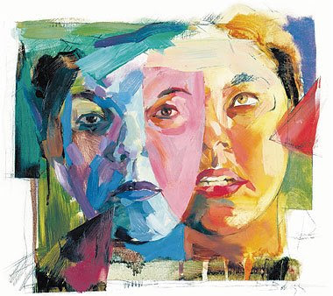
Schizophrenia & other psychotic disorders
Psychiatry department
Beni Suef University

Slide 2
Schizophrenia
It is described as "a disturbance that lasts for at least 6 months and includes at least a month of active phase symptoms; that is, two or more of the following:
delusions, hallucinations, disorganized speech, grossly disorganized or catatonic behavior, and negative symptoms (i.e.. affective flattening or avolition).

Slide 3
Epidemiology of Schizophrenia
* Lifetime prevalence: 1 %.
* Equally prevalent in men and women.
* Peak age at onset : 15-25 years for males, and 25 - 33 years for females.
* Rare before 10 years and above 50 years.
* Equal incidence among social classes, but prevalence is more in lower socioeconomic groups.
* Increased prevalence in high density population in and with immigration.

Slide 4
Etiology of Schizophrenia
It is heterogonous disorder with variable etiology, but with somewhat similar behavioral symptoms.
Stress-diathesis (vulnerability) model is a model that integrates biological, psychosocial and environmental factors (i.e., biopsychosocial interactions).

Slide 5
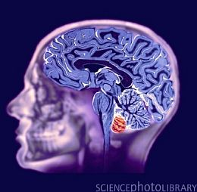
Biological factors:
• Genetic Factors:
Abnormalities in chromosomes 5, 11, 18, and 19; and X- chromosomes are associated with schizophrenia.
• Anatomical changes: the limbic system, frontal cortex and basal ganglia are interconnected.

Slide 6
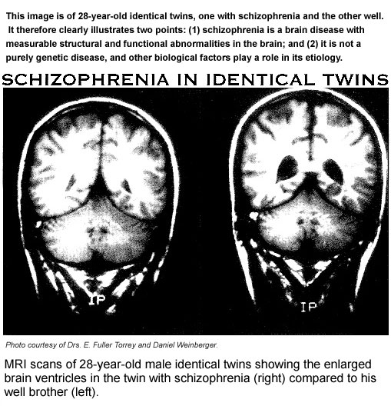

Slide 7
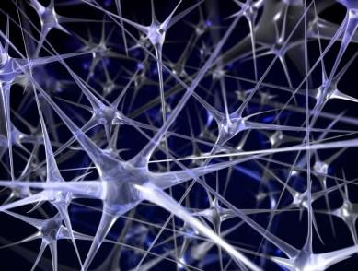
Biological factors:
Neurotransmitters : excessive dopaminergic activity is related to schizophrenia.
Other neurotransmitters are also important such as:
serotonin, norepinephrine, and amino acids such as glutamate and GABA.
This view is supported by the efficacy of typical and atypical antipsychotics in treatment of schizophrenia.

Slide 8
Biological factors:
• Brain imaging:
indicate cerebral asymmetry, reduced cerebellar volume, ventricular enlargement, and frontal hypo-activity with decreased cerebral blood flow in dorsolateral prefrontal cortex while performing cognitive tasks.
• Evoked potentials: Smaller and delayed P300 wave indicate blunting of the information processing at higher cortical level.

Slide 9
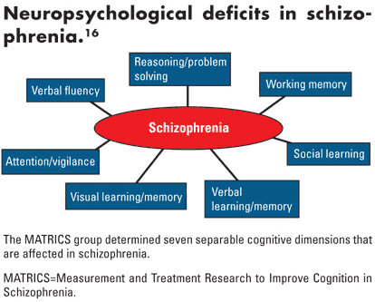

Slide 10
Psychosocial Factors:
• Role of family: types of abnormal relations between family members share in abnormal psychological upbringing.
• Learning theories: the patient learns irrational reactions and ways of thinking by imitating parents with significant emotional problems.
• Social theories: immigration, industrialization and urbanization are involved in the etiology of schizophrenia.

Slide 11
Diagnosis and clinical picture
The following symptoms are highly suggestive of schizophrenia, if they are fixed and prominent in the course of the illness:
• Disorders in the form of thinking (formal thought disorders):
loosening of association, derailment, and incoherence
• Delusion of control, thought insertion, thought withdrawal and thought broadcasting
• Bizarre delusions and behavior

Slide 12
Diagnosis and clinical picture
•Third person auditory hallucinations
• Commanding auditory hallucinations with the patient obeying those commands even if absurd, irrational or dangerous
Flattening of affect, inappropriate affect and marked ambivalence
• Marked social withdrawal, not secondary to a delusion or a depressed mood.

Slide 13
Diagnosis and clinical picture
Symptoms of schizophrenia are generally divided into positive symptoms and negative symptoms.
a. Positive symptoms include all manifestations related to delusions and hallucinations.
They usually respond to typical antipsychotics.
b. Negative symptoms include flat affect, social withdrawal and avolition. They are usually handicapping.
They respond to atypical antipsychotics

Slide 14
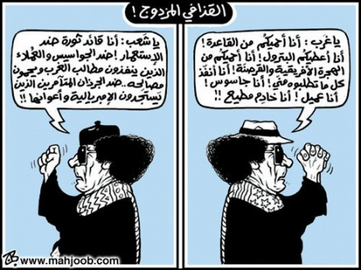

Slide 15
Types of Schizophrenia
Disorganized Schizophrenia
Paranoid Schizophrenia
Catatonic Schizophrenia
Undifferentiated Schizophrenia
Residual Schizophrenia
Schizoaffective Disorder
Simple Schizophrenia

Slide 16
Disorganized Schizophrenia
• All symptoms of schizophrenia are present
• Delusions are bizarre, fragmented and malsystematized
• Speech and behavior are grossly disorganized
• There is marked social and occupational deterioration

Slide 18
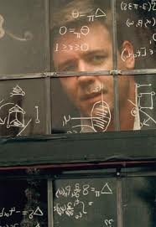
2- Paranoid Schizophrenia
• There is preoccupation with one or more delusions, or frequent hallucinations.
• None of the following is prominent: disorganized speech; disorganized or catatonic behavior; flat or inappropriate affect.
• Social dysfunction and occupational deterioration is less than all the other types.

Slide 19
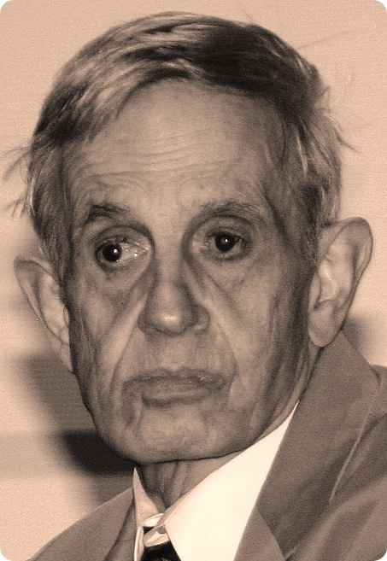
Prof. Nash; Mathematician a beautiful mind

Slide 20
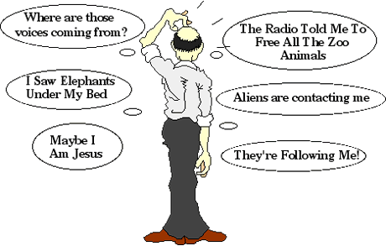

Slide 21
3- Catatonic Schizophrenia
This is a type of schizophrenia where catatonic features dominate the clinical picture (see chapter on symptomatology)
• Other symptoms of schizophrenia are present as well
• Social and occupational deterioration is profound

Slide 22
4- Undifferentiated Schizophrenia
• It is an intermediate form between paranoid and
disorganized types
• Delusions and hallucinations are less than those
encountered in paranoid schizophrenia
• Disorganization is less than that seen in the disorganized type
• Social dysfunction and occupational deterioration is intermediate between the paranoid type and the disorganized type.

Slide 23
5- Residual Schizophrenia
• Symptoms and deterioration in functioning are even less than that seen in the undifferentiated type.
• It is usually the result of partial improvement on treatment

Slide 24
Simple Schizophrenia
• There are no positive symptoms. " There is only vague thinking, flat affect and social withdrawal.
• Occupational deterioration is very gradual but profound
• Onset is usually in early adolescence. It is very gradual over many years. Course is slowly progressive.
• The family usually recognizes the change in personality after many years of deterioration.
• It is one of the most malignant types of schizophrenia.

Slide 25
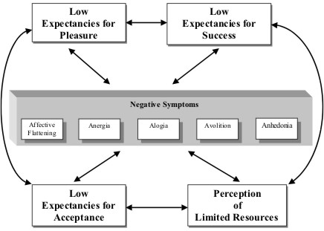

Slide 26
- Schizoaffective Disorder
• There is a prominent and persistent mood disturbance in the form of depression or elation, in the presence of schizophrenic symptoms.
• The diagnosis is given to cases when neither a mood disorder nor a frank schizophrenia can be diagnosed

Slide 27
Schizoaffective Disorder
• Two types are recognized:
- Schizoaffective disorder - depressive type
- Schizoaffective disorder - bipolar type
" Some authors do not consider this disorder as a type of schizophrenia.
It is an intermediate disorder between mood disorders and schizophrenia.

Slide 28
Course and Prognosis
Schizophrenia usually runs a chronic course with remissions and exacerbations.
Exacerbations are usually related to psycho-social stresses (family environment, unemployment) and non-compliance to medications.

Slide 29
Course and Prognosis
30 % of all schizophrenic patients are able to lead a normal life.
30 % of patients continue to experience moderate symptoms with variable degrees of social adaptation.
40 % of patients are significantly impaired. In most cases, this is caused by non-compliance to treatment.

Slide 30
Course and Prognosis
The introduction of atypical antipsychotics in the last decade has changed dramatically the prognosis of schizophrenia.
The quality of life and cognitive functions of patients are much better with the atypical antipsychotics.

Slide 31
Treatment of Schizophrenia
Treatment of schizophrenia necessitates a multi-modal approach.
It is tailored according to the patient's clinical picture, social support system, education, premorbid functioning, previous therapeutic efforts, and his special problems with reintegration into the society.

Slide 32
Treatment of Schizophrenia
(A) Hospitalization
(B) Pharmacotherapy
(C) Psychotherapy
(D) Electro-Convulsive Therapy (ECT)

Slide 33
(B) Pharmacotherapy
• Typical antipsychotic: for positive symptoms, they show 60-70% response.
They have a high side-effect profile.
Examples: haloperidol, trifluoperazine, and chlorpromazine.
• Atypical antipsychotic: for both positive and negative symptoms; with resistant cases; or intolerant cases for side-effects.
Examples: clozapine, risperidone, and olanzapine.

Slide 34
DELUSIONAL DISORDERS
Definition
Delusional Disorders are defined as psychiatric disorders in which the predominant symptoms are delusions.

Slide 35
DELUSIONAL DISORDERS
Epidemiology
Delusional disorder may be underreported because delusional
patients rarely seek psychiatric help unless forced to do so. The
prevalence of delusional disorder in the United States is currently estimated to be 0.025 to 0.03 percent.
The annual incidence of delusional disorder is 1 to 3 new cases per 100.000 people.

Slide 36
Etiology of Delusional disorder
1- Biological Factors
A wide range of non-psychiatric medical conditions and substances (psychoactive stimulants and alcohol) can cause delusions.
limbic system and basal ganglia
abnormal experiences in the environment, the peripheral nervous system, or the central nervous system.

Slide 37
Etiology of Delusional disorder
2- Psychodynamic Factors
Many patients with delusional disorder are socially isolated and have attained less than expected levels of achievement.
Some paranoid patients experience a lack of trust in relationships.
Patients with delusional disorder use primarily the defense mechanisms of reaction formation, denial, and projection.

Slide 38
Clinical features of Delusional disorder
Patients are usually well groomed and well dressed, without evidence of gross disintegration of personality or of daily activities, yet they may seem eccentric, odd, suspicious or hostile.
Disorder of thought content, in the form of delusions, is the key symptom of the disorder.
The delusions are usually systematized and are characterized as being possible.
The delusional system itself may be complex or simple. Patients lack other signs of thought disorder.

Slide 39
Delusional disorder Types
1- Erotomanic Type
2- Grandiose type
3- Jealous type
4- Persecutory Type.
5- Somatic type

Slide 40
Delusional disorder
Differential Diagnosis
secondary to abuse of psychoactive stimulants and alcohol.
Part of Organic mental disorder (basal ganglia and the limbic system).
Schizophrenia,
Mood Disorders,
Obsessive-Compulsive Disorder,
Somatoform Disorders, and
Paranoid Personality Disorder.

Slide 41
Delusional disorder
Course and prognosis
A sudden onset is more common than an insidious onset.
fairly stable diagnosis:
>25 % later diagnosed as schizophrenia, and
>10 have a mood disorder.
50 % recovered at long-term follow-up,
20 % show a decrease in symptoms, and
30 % have no change in symptoms.

Slide 42
Treatment of Delusional disorder
1- Hospitalization:
2- Pharmacotherapy: Antipsychotic drugs are the treatment of choice for delusional disorders.
3- Psychotherapy:
4- Family therapy:

Slide 43
Thank you

