Slide 1
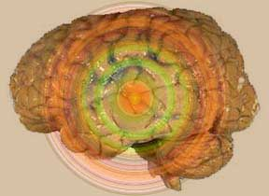
Symptomatology in psychiatric illness
Psychiatry department
Beni Suef University

Slide 2
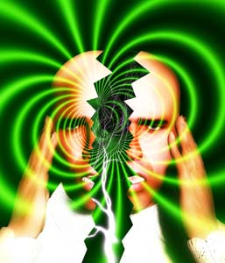
Psychiatric Symptoms and Signs
I . Disorders of Perception
II- Disorders of Thinking
III. Disorders of Speech
IV- Disorders of Emotions
V. Disorders of Motor Behavior
VI- Disorders of Memory
VII- Disorders of Attention
VIII- Disorder of Orientation
IX- Disorders of Consciousness
X- Judgment
XI- Insight

Slide 3
I . Disorders of Perception
Perception is the process by which sensory stimuli are given a meaning (i.e., transferring physical stimulation into psychological information). Common disorders of perception are the following:
1. Illusions:
• Misinterpretation of real external sensory stimuli (e.g., mistaking a rope for a snake, mirage).
• May affect any sensory modality (visual, auditory, etc...).
• May occur in normal or pathological conditions (e.g., delirium).
2. Hallucinations:
Hallucination is a false perception in the absence of any external stimulus.
3.Depersonalization and Derealization:

Slide 4
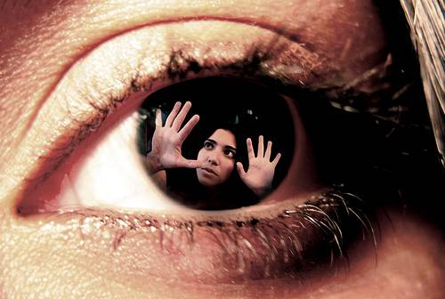
Types of Hallucinations
According to complexity:
• Elementary (e.g., noises, flashes of light).
• Complex (voices, music, faces, scenes).
According to sensory modalities :
a. Auditory Hallucinations:
b. Visual Hallucinations:
c. Tactile Hallucinations:
d. Olfactory (smell) and Gustatory (taste) Hallucinations:
e. Somatic Hallucinations:

Slide 5
Auditory hallucinations
They are the most common type of hallucinations. They mainly occur in psychotic disorders especially schizophrenia.
Varieties:
• Voices talking to the patient (2nd person), i.e., addressing or commanding
• Voices talking about the patient (3rd person), e.g., commenting on his thoughts or actions
• Voices repeating patient's thoughts (echo de pensee)

Slide 6
b. Visual Hallucinations:
• Most common in organic mental conditions, (e.g., delirium, substance intoxication or withdrawal).
• May occur in schizophrenia, severe mood disorders or dissociative disorders.

Slide 7
c. Tactile Hallucinations:
• False perception of touch.
• e.g., phantom limb (from amputated limb); and crawling sensation on or under the skin in cocaine intoxication and withdrawal.

Slide 8
d. Olfactory (smell) and Gustatory (taste) Hallucinations:
• Most common in organic conditions, e.g., temporal lobe epilepsy.
• May occur in schizophrenia or severe mood disorders.

Slide 9
e. Somatic Hallucinations:
• False sensation of things occurring in the body (mostly visceral). They usually occur in psychotic disorders, particularly schizophrenia.

Slide 10
3.Depersonalization and Derealization:
Disturbed perception of oneself or the surrounding environment:
a. Depersonalization: the person perceives himself, his body or parts of his body as different, unreal or unfamiliar.
b. Derealization: the person perceives the external world, objects or people as different, strange or unreal.
Depersonalization and Derealization may occur in normal people (during stress), in anxiety disorders, mood disorders, schizophrenia, and in organic conditions (e.g., temporal lobe epilepsy).

Slide 11
II- Disorders of Thinking
These are classified into:
• Disorders of Form of Thinking
• Disorders of Stream of Thinking
• Disorders of Content of Thinking

Slide 12
(A) Disorders of Form of Thinking
They are also called Formal Thought Disorders.
They are abnormalities in the logical structure and association of thoughts.
They lead to failure in producing coherent and logically connected meanings.
Formal thought disorders usually occur in psychotic disorders and some organic mental disorders.

Slide 13
(A) Disorders of Form of Thinking
The following are the commonest types.
1.Loosening of associations:
2. Incoherence:
3. Word Salad:
4. Verbigeration:
5. Perseveration:
6. Neologism:
7. Clang associations:

Slide 14
(B) Disorders of Stream of Thinking
These are abnormalities in the progress of thought including its speed (tempo) and continuity.
1. Flight of ideas:
2- Circumstantiality:
3 - Blocking:

Slide 15
(C) Disorders of Content of Thinking
These are abnormalities in the ideas or beliefs contained in thought.
a. Delusions
b. Obsessions

Slide 16
Delusions:
• A delusion is a false belief.
• It is based on incorrect inferences about reality.
• It is not consistent with the patient's cultural background.
• It cannot be corrected by experience or reasoning.
Delusions may be:
• Fixed (complete conviction all the time) or shakable (lacking full conviction sometimes).
• Systematized (i.e., united by or centered on a single theme or idea with many connected details) or malsystematized (i.e.. disconnected or shifting from one theme to another).
• Bizarre (i.e., with very strange or absurd content).
N.B. Delusions and Hallucinations occur in psychotic disorders such as:
1- Schizophrenia.
2- Delusional disorders.
3- Psychotic mood disorders.
4- Some organic or substance related mental disorders.

Slide 17
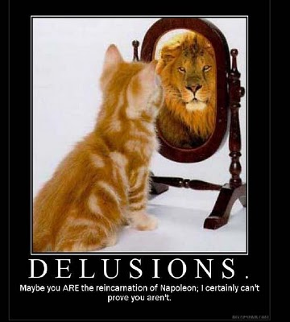
(C) Disorders of Content of Thinking
These are abnormalities in the ideas or beliefs contained in thought.
Types of Delusions (according to theme):
1. Delusion of persecution:
2. Delusion of grandeur (grandiosity):
3. Delusion of reference:
4. Delusion of guilt or self accusation.
5. Nihilistic delusion:
6. Somatic delusion:
7. Hypochondriacal delusion:
8. Delusion of infidelity (delusional jealousy):
9. Erotomania (delusion of love):
10. Delusions of influence & control (Passivity phenomena):

Slide 18
Delusions of control:
•This is a false belief that a person's thoughts, feelings, actions or will are being controlled by external forces.
• Delusions concerning the possession of thoughts:
i. Thought insertion:
ii. Thought withdrawal:
iii. Thought broadcasting:

Slide 19
b. Obsessions:
• Obsessions are recurrent, persistent thoughts, impulses or images that cannot be eliminated from consciousness by logic or reasoning although the person is aware that they are unreasonable, absurd and alien to him (ego-dystonic).

Slide 20
Compulsions
If the thought urges the patient to perform a certain act, repetitive compulsion results, e.g., obsession of dirt leads to compulsive washing. Like obsessions, compulsions are recognized as senseless and alien.

Slide 21
III. Disorders of Speech
1- Volubility :
2- Poverty of speech:
3- Poverty of content of speech (poverty of thought):
4- Stuttering and stammering:
5- Dysarthria:
6- Aphasia:
Motor aphasia (expressive):
Sensory aphasia (receptive):
Nominal aphasia:
7- Mutism:

Slide 22
IV- Disorders of Emotions
Emotion is a complex feeling state with psychic, somatic and behavioral components.
The clinical study and evaluation of emotion is concerned with two main aspects:
A-Mood: a sustained and pervasive emotional tone subjectively experienced and reported by the patient and observed by others (e.g., depression, elation, anger).
B- Affect: usually used to indicate the subjective and immediate "short lived" or transient experience of emotion. It also refers to the external expression or observed aspect of emotions.

Slide 23
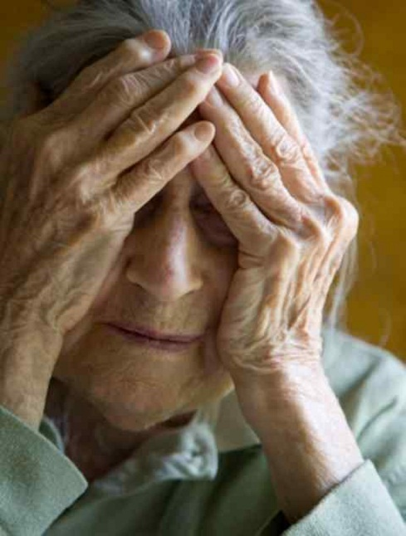
A- Disorders of Mood:
Disorders of mood may be unpleasant or pleasant.
Unpleasant moods
Dysphoric mood: Irritable mood:
Depression: Anhedonia
Fear Anxiety
Free-floating anxiety Tension
Phobia

Slide 24
Pleasant Moods:
1-Euphoria
2- Elation
3- Ecstasy:

Slide 25
B- Disorders of Affect:
These are disturbances related to observed expression of emotions. They include the following disorders:
1. Constricted or restricted affect
2. Blunted affect
3. Flat affect (apathy)
4.Inappropriate affect (incongruity of affect)
5. Lability of affect (emotional incontinence)
6. Swings of affect
7. Ambivalence

Slide 26
V. Disorders of Motor Behavior
1- Tics
2- Mannerisms
3- Stereotypy
4- Psychomotor retardation
5- Psychomotor agitation
6- Excitement
7- Lack of Volition (Avolition)
8- Catatonic Symptoms

Slide 27
8- Catatonic Symptoms
a. Catalepsy:
b. Catatonic Posturing
c. Catatonic rigidity
d. Waxy flexibility
e. Catatonic Stupor:
f. Catatonic Excitement:
g. Negativism
h. Automatic obedience
i. Echolalia
j. Echopraxia

Slide 28
VI- Disorders of Memory
Memory is the psychological function by which information stored in the brain is later recalled in consciousness.
Clinically, 4 levels of memory are described:
Immediate Memory
Recent (short-term) Memory
Recent Past Memory
Remote (Long-term)

Slide 29
Disorders of Memory:
A- Amnesia
1. Anterograde
2. Retrograde
3. Circumscribed amnesia (amnestic gap)
B- Hypermnesia
C- Paramnesia
It is falsification or distortion of recalled memories. Common types:
1- Confabulation
2- Retrospective Falsification
3- Deja vu
4- Jamais vu

Slide 30
VII- Disorders of Attention
Attention is the ability to focus awareness on certain important or relevant aspects of an experience, activity or task. Concentration is the ability to sustain or maintain that focus.
Disorders of Attention:
1. Distractibility
2. Selective inattention
3. Hypervigilance (hyperprosexia)

Slide 31
VIII- Disorder of Orientation
Orientation is awareness of time, place and persons.
Disorientation : disturbed orientation to time, place or persons. It is usually related to disturbed consciousness.

Slide 32
IX- Disorders of Consciousness
Consciousness is the general state of awareness of the self and the environment.
Common disorders of consciousness are:
1- Clouding of Consciousness:
2- Stupor:
3- Coma:
4- Dream-like state (oneroid or twilight state):
5- Somnolence:
N.B.: Most symptoms indicating disturbances in
consciousness, orientation, memory, and attention
highly suggest an "Organic Mental Disorder".

Slide 33
X- Judgment
Judgment is the ability to assess a situation rationally and to act appropriately within that situation. Judgment has several aspects (cultural, social, moral, etc...) that should be considered in order to be assessed by the clinician.

Slide 34
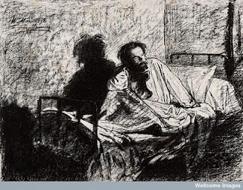
XI- Insight
In psychiatry, insight refers to the
patient's conscious recognition of his condition, i.e., awareness that:
1 - he is disturbed or ill
2- his illness is psychiatric in nature
3- he should seek professional help
4- he should cooperate with the offered treatment
Full or partial awareness of these aspects indicates the degree of his insight.

Slide 35
Thank You

