Slide 1
Acute Kidney Injury
Dr; Mahmoud Hassan Adawy
MD, internal medicine & nephrology

Slide 8
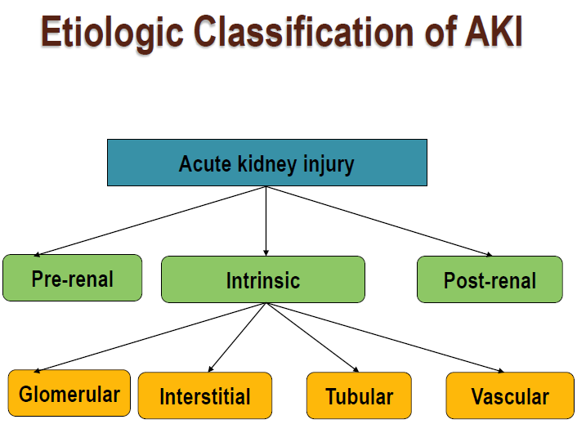

Slide 9
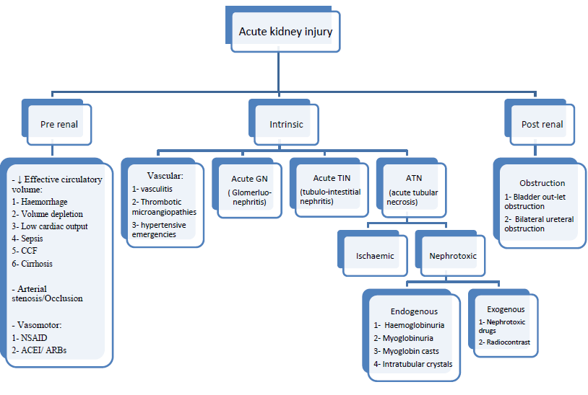

Slide 13
