Slide 1
Cryoglobulinemia
Ahmed Yehia, MD

Slide 2
What are cryoglobulins?
Cryoglobulins are immunoglobulins (Igs) or Ig-containing complexes that spontaneously precipitate from serum and plasma at low temperatures and become soluble again with rewarming.

Slide 3
Brouet et al published a classification system for cryoglobulinemia in 1974, which is still in use today.
Type I
single monoclonal Ig, with IgM being the most common.
Serum levels of cryoglobulin are very high (5–30 mg/mL, cryocrit >5%)
precipitation occurs rapidly with cooling (usually <24 hours).
Type II: mixed cryoglobulins
a monoclonal Ig (typically IgM) that acts as an antibody (e.g., rheumatoid factor [RF]) against polyclonal Ig (typically IgG).
Serum levels are intermediate (1–10 mg/mL, cryocrit 1%–5%);
precipitation may take a few days.
Type III: mixed cryoglobulins
polyclonal Ig with RF activity directed against polyclonal Ig.
small quantities (0.1–1 mg/mL, cryocrit <1%)
precipitate slowly (up to 7 days); therefore they are more difficult to detect.
Type II to III: unusual
oligoclonal IgM and faint polyclonal Igs.
represent a transition from polyclonal (type III) to monoclonal (type II) mixed cryoglobulinemia (MC) as clonal expansion of B cells progresses

Slide 4
What underlying disorders
type I cryoglobulinemia
Lymphoproliferative disorders which are associated with monoclonal Ig production 6.
MC
Infections
autoimmune/ autoinflammatory diseases
Lymphoproliferative processes.
Only (<5%) are truly “essential” cryoglobulinemia.
HCV infection, the most common

Slide 5
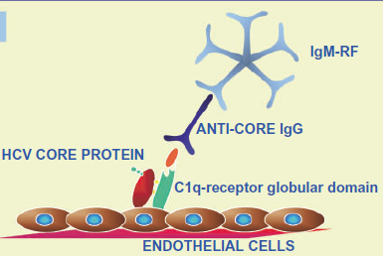
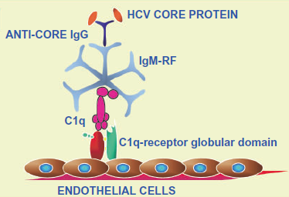
Mixed Cryoglobulinemia
Systemic vasculitis affecting small- and medium-sized arteries and veins.
Characterized by the deposition of immune complexes containing rheumatoid factor (RF), IgG, HCV RNA, and complement on endothelial surfaces
In HCV MC blood tests show elevated serum RF, positive cryoglobulins and low complement (particularly C4)

Slide 6
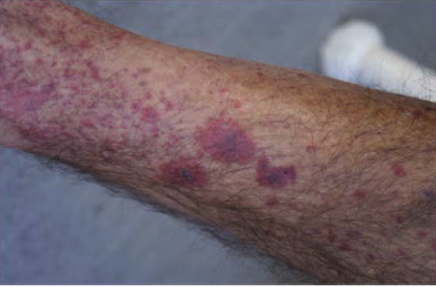
Skin Involvement
Palpable purpura, primarily of the lower legs, occurs in more than 90% of patients with symptomatic HCV MC
Frequently intermittent
Often initial manifestation of HCV MC
Purpuric lesions may occasionally progress to chronic ulcers and frank gangrene

Slide 7
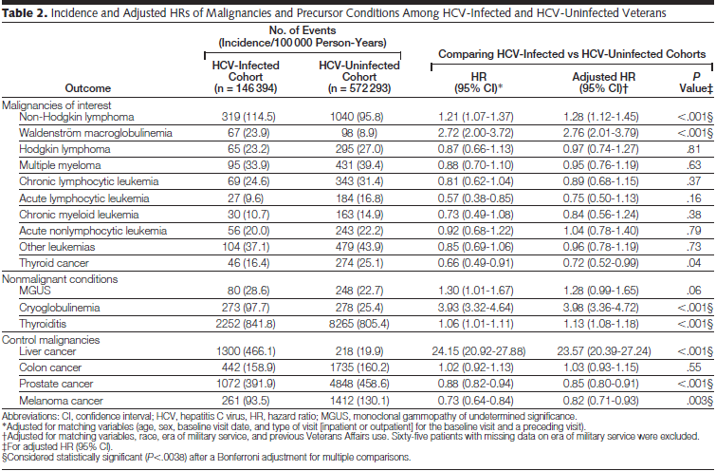
HCV Related Lymphoproliferation
Giordona. JAMA 2007. 297 2010-2017
Notes:
(Giordona. JAMA 2007) Large retrospective trial has confirmed that HCV is associated with: NHL, Waldenstrom macroglobulinemia, and MGUS

Slide 8
A.L. Zignego et al. / Autoimmunity Reviews 8 (2008) 107–111
Notes:
1) Possible mechanisms involved in the pathogenesis of MC and/or other
HCV-related LPDs
2) HCV chronic infection is responsible for sustained B-cell proliferation which could favor the occurrence of errors during V(D)J rearrangement processes—namely t(14;18) translocation
3) Bcl-2 over-expression could lead to abnormally prolonged B-cell life.
4) The inhibition of B-cell apoptosis may favor the lack of silencing RF B-cells as well as the acquisition
of additional genetic aberrations, which might ultimately lead to transformation to a frank malignancy.

Slide 9
Treatment
Saadoun. Rheumatology 2007;46:1234–1242
Notes:
Antiviral therapy may clear the antigen (i.e. HCV) trigger of MC vasculitis.
Anti-CD20 mAb target the B-cell, involve in the cryoglobulin formation and possibly in the antigen presentation to T lymphocytes
Immunosuppressive agents and corticosteroids control the cellular and humoral immune response responsible for vasculitic lesions.
Plasmapheresis may be useful for patients presenting with the most fulminant presentations including peripheral necrosis of extremities or rapidly progressive nephritis.

Slide 10
C/P ot type 1
Hyperviscosity syndrome (bleeding, vision changes, neurologic symptoms, etc.)

Slide 11
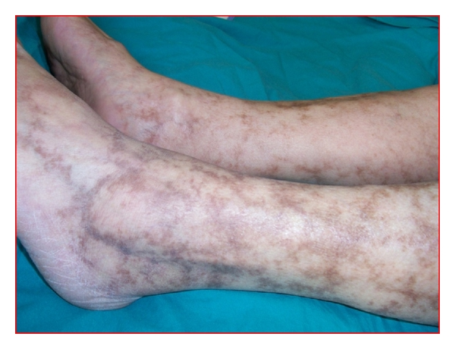
MC, cutaneous manifestations are the most common, with arthralgias and neuropathy being other frequent findings.

Slide 12
aMeltzer’s triad = purpura + arthralgias + weakness/myalgias.

Slide 13
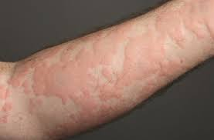
Urticarial vasculitis

Slide 14
Indications of skin biopsy in chronic urticaria
Poor response to antihistaminics.
Persistence of individual lesion > 24 hours.
Petichae or purpura.
Presence of systemic manifestations e.g. fever, arthritis.
Postinflammatory pigmentation after wheal resolution.

Slide 15
Common laboratory abnormalities in mixed cryoglobulinemic vasculitis
Elevated RF
Hypocomplementemia. Notably, C4 is reduced out of proportion to C3.
A polyclonal hypergammaglobulinemia or monoclonal gammopathy are also frequently seen.
Markedly elevated ESR, CRP.

Slide 16
Autoantibodies (other than RF) are seen in more than half of patients
antinuclear,
antismooth muscle,
ANCA,
antithyroid,
Antimitochondrial
antiphospholipid antibodies.

Slide 17
How is the diagnosis of mixed cryoglobulinemic vasculitis established?
Detection of cryoglobulins in the right clinical setting is diagnostic.
Given the fact that false-negative results are common due to sample mishandling, the absence of cryoglobulins does not exclude the diagnosis.
A high level of suspicion should be maintained if characteristic clinical and laboratory features are present.
Elevated RF, low complement level, monoclonal gammopathy (especially when found together) may serve as a surrogate marker of cryoglobulinemia.

Slide 18
How is the diagnosis of mixed cryoglobulinemic vasculitis established?
Biopsy of affected tissue (typically skin) demonstrates leukocytoclastic vasculitis, and intravascular hyaline thrombi may also be seen. Immunofluorescence typically demonstrates Ig and C3 deposition. Biopsies of liver or bone marrow may demonstrate clonal expansions of B cells.

Slide 20
Saadoun. Rheumatology 2007;46:1234–1242

