Slide 2
It is the second most common form of chronic arthritis. It leads to: 1) Symmetrical inflammatory polyarthritis affecting mainly peripheral small joints, with progressive joint damage. 2) Extra articular manifestations.

Slide 3
Aetiology:
(unknown)
* Autoimmune. * HLA association e.g: HLA DR4.

Slide 4
Pathogenesis:
* Infiltration of the synovial membrane by inflammatory cells. * Thickening of synovial membrane. * Erosion of the articular cartilage. * Deformity of the joint .

Slide 6
Clinical picture :
Type of patient : females : males = 3:1, (30 - 40) years old. Life -long course with intermittent remissions & exacerbations. May be present by constitutional symptoms : fever , weight loss& easy fatigability.

Slide 7
1- Musculoskeletal manifestations: *The commonest presentation is gradual & slowly progressive symmetrical polyarthritis affecting small joints of the hands, wrist & feet. *Pain, swelling, stiffness with effusion in large joints. *Morning stiffness: which decrease toward end of the day.

Slide 8
A) Hands: *Proximal interphalangeal joints (PIP). *Metacarpophalangeal joints .
*Distal interphalangeal joints are usually spared (DIP).

Slide 10
Common deformities:
1- Ulnar deviation of metacarpophalangeal joints due to subluxation. 2- Swan neck deformity: flexion of DIP & hyperextension of PIP. 3- Boutonnière: flexion of PIP & hyperextension of DIP. 4- Z-deformity of the thumb: flexion of the metacarpophalangeal joint & hyperextension of interphalangeal joint. 5- Trigger finger: inability of extend finger at metacarpophalangeal joint.

Slide 11
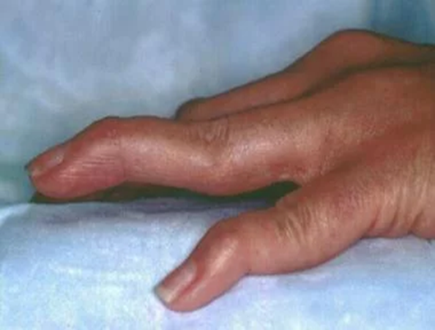

Slide 12
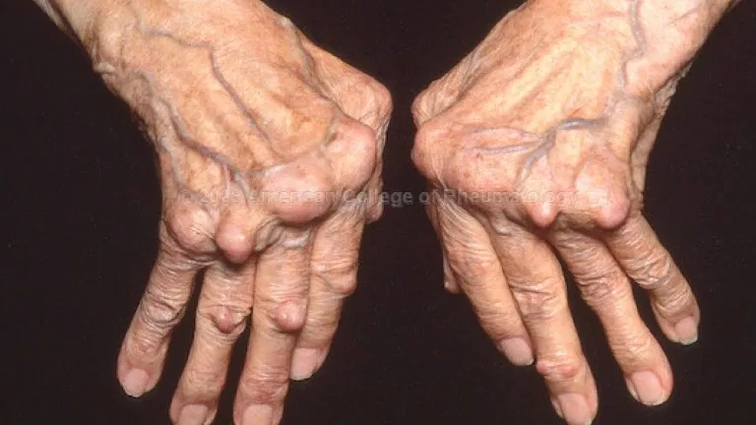

Slide 14
B) Feet: 1- Metatarsophalangeal & interphalangeal arthritis. 2- Achilles tendinitis.

Slide 16
C) Cervical spine: 1- Atlantoaxial subluxation with spinal cord compression leading to pyramidal & sensory signs. 2- Suspect it in any patient with RA with new onset of occipital headache.

Slide 17
D) Temporomandibular, cricoarytenoid& sternoclavicular Joints affection.
E) Knee arthritis: with possibility of formation of Baker `s cyst (painful swelling of popliteal fossa). F) Wrists & elbows: and other joints can be affected.

Slide 18
2- Skin: * Subcutaneous rheumatoid nodules. * Palmer erythema. * Raynaud`s phenomenon.

Slide 20
3- Neurological features: * Carpal tunnel syndrome (median nerve compression). * Cervical cord compression due to atlantoaxial subluxation. * Polyneuropathy.

Slide 21
4- Renal affection: * RA itself usually doesn`t lead to GN. * Main cause of GN is drugs used in the ttt. e.g: NSAIDS. * RA lead to amyloidosis kidney. 5- Heart: * Pericarditis, myocarditis, endocarditis.

Slide 22
6- Respiratory: * Pleural effusion. * Rheumatoid pulmonary nodules. * Interstitial lung disease. 7- Eye: * Sjogren`s syndrome. * Scleritis , lritis.
8- Blood: * Anemia of chronic disease.

Slide 23
Felty syndrome:
triad of rheumatoid arthritis, splenomegaly and neutropenia.
It is seen in patients with seropositive disease with hepatomegaly, thrombocytopenia, lymphadenopathy and fevers.

Slide 25
Investigations
1- CBC: normocytic normochromic anemia (anemia of chronic disease). 2- ESR & CRP: increase (markers of disease activity). 3- Serology: * RF : positive in 80% of cases ( not specific , not sensitive ) * Anti CCP (cyclic citrullinated peptide antibodies): positive in 80% of cases (specific). * ANA : positive in 20% of the cases (not specific).

Slide 26
4- Imaging: * X-ray: 1- Early : narrow joint space due to destruction of the cartilage. 2- Late: deformity . * Musculoskeletal ultrasonography
* MRI.
5- Synovial fluid analysis : in case of joint effusion

Slide 28
Treatment
A) Non pharmacological: * Bed rest during activity. * Splinting: decrease pain & prevent deformity. * Physiotherapy: when pain subside.

Slide 29
B) Pharmacological: 1- NSAIDs: * No disease modifying effect . * For relieve of pain &stiffness . * e.g: ketoprofen, Diclofenac, Meloxicam . * SE. : nephrotoxic, GIT irritation, antiplatelet effect & hepatotoxic.

Slide 30
2- Glucocorticoids: * No disease modifying effect . * For relieve of pain &stiffness . * eg. : low dose
prednisolone (5-10)mg/day . * SE.: hypertension , DM , osteoporosis , peptic ulcer & weight gain.

Slide 31
3- Disease Modifying Anti Rheumatic Drugs: (DMARDs) * Decrease progression of erosive changes & decrease activity of the disease. * Improve symptoms eg; pain later on, not immediate effect.

Slide 32
I. Methotrexate : (MTX) * SC, IM injection, oral. * SE : GIT upset , hepatotoxic, anemia, thrombocytopenia & leucopenia.

Slide 33
II. Leflunomide: * oral. * SE : skin rash, GIT upset. III. Hydroxychloroquine : * oral. * SE : retinopathy.

Slide 34
IV. Sulphasalazine: * oral . * SE : skin rash , bone marrow depression . V. Other DMARDs : * Gold , penicillamine. * Less commonly used (highly toxic)

Slide 35
4- Biological therapy: * IL1 , IL6 receptor antagonist . * Anti TNF monoclonal antibody . C) Surgical ttt: * eg : joint replacement.

Slide 36
QUESTIONS

Slide 37
The following are features of osteoarthritis but not rheumatoid
arthritis:
A. Joint swelling
B. Heberden’s nodes
C. More common in women
D. Negative rheumatoid factor
E. Treatment may include joint replacements

Slide 38
A 36-year-old woman presents to the rheumatology outpatient clinic with a two-month history of stiff hands and wrists. She mentions that the pain is particularly bad for the first few hours after waking up and is affecting her work as a dentist. On examination, the wrists, metacarpophalangeal joints and proximal
interphalangeal joints are swollen and warm. What is the most likely diagnosis?
A. Rheumatoid arthritis
B. Osteoarthritis
C. Septic arthritis
D. Polymyalgia rheumatica
E. Reactive arthritis

Slide 39
A 50-year-old woman, who has received a recent diagnosis of rheumatoid arthritis,
presents to her GP with ongoing pain and stiffness in her hands and feet. Which
joints are usually spared at onset of rheumatoid arthritis?
A. Proximal interphalangeal joints
B. Distal interphalangeal joints
C. Metacarpophalangeal joints
D. Wrists
E. Metatarsophalangeal joints

Slide 40
A 30-year-old woman presents to accident and emergency with worsening stiffness
in the hands, wrists and feet. She mentions that the pain has been particularly bad
in the mornings. On examination, there is a palpable spleen. Initial blood tests reveal
a low neutrophil count and a raised C-reactive protein. The most likely diagnosis is:
A. Felty’s syndrome
B. Reactive arthritis
C. Still’s disease
D. Infectious mononucleosis
E. Serum sickness

Slide 41
Thank you

