Slide 1
Electro-Convulsive Therapy (ECT)
Psychiatry department
Beni Suef University

Slide 2
Electro-Convulsive Therapy (ECT)
Mode of Action
It is done through the passage of an electric current capable of inducing a generalized seizure activity in the brain.
The mechanism of action is not clear, but ECT is one of the most efficient methods of treatment in psychiatry.
It has the least complications when applied properly.

Slide 3
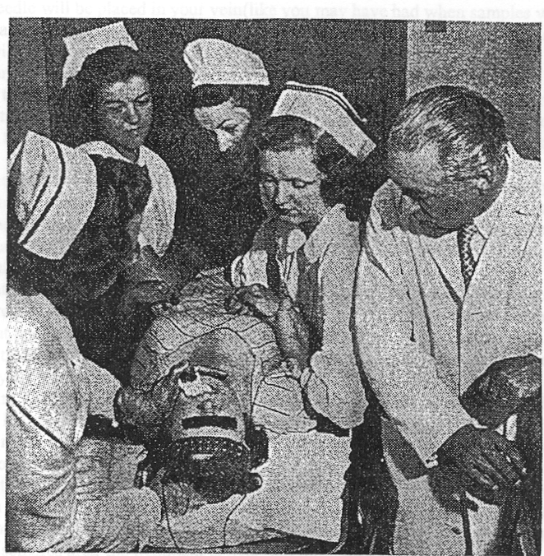

Slide 4
Electro-Convulsive Therapy (ECT)
Technique
• Thorough physical examination.
• Patient is fasting and artificial dentures are removed. A mouth gag is applied to protect teeth and tongue.

Slide 5
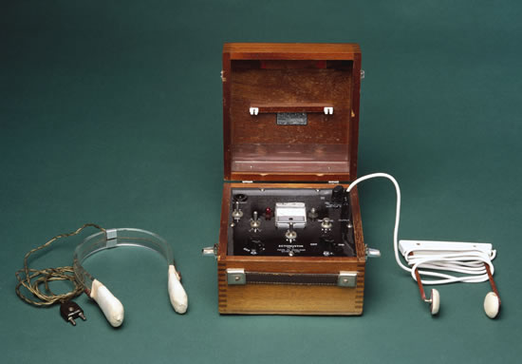

Slide 6
Electro-Convulsive Therapy (ECT)
• Premedication and anesthesia:
- Atropine (0.5 mg I.M.) to protect the heart from
parasympathetic overtone and reduce bronchial secretions.
- Short acting anesthesia (e.g., thiopental I.V.), a sleeping dose is needed.
- Muscle relaxant (e.g., succinylcholine) in full dose to minimize or prevent convulsions.

Slide 7
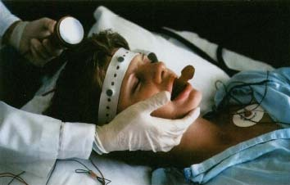

Slide 8
Electro-Convulsive Therapy (ECT)
• Application of electrodes:
1- Bilateral (more effective): bifrontotemporal application of the electrodes.
2- Unilateral applied to non-dominant hemisphere (less cognitive side-effects).

Slide 9
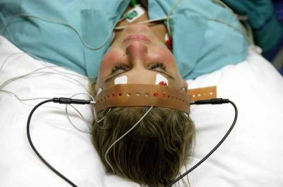

Slide 10
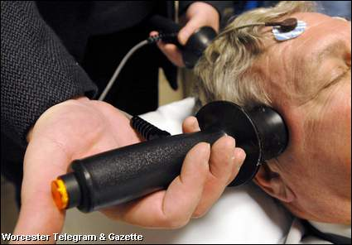

Slide 11
Indications of ECT
1- Major Depression.
2- Bipolar Mood Disorder.
3- Acute psychotic disorders:
- Undifferentiated and brief psychotic disorders.
- Acute delusional disorders.
4- Schizoaffective disorders.
5- Schizophrenia:
- With catatonic symptoms.
- With mood (depressive symptoms).
- With acute exacerbation of symptoms.

Slide 12
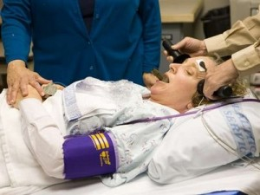

Slide 13
ECT
Contraindications (Relative Not Absolute)
1 - Recent myocardial infarction.
2- Increased intracranial tension, cerebral aneurism or hemorrhage.
3- Extreme hypertension.
4- Fever or acute respiratory infection.
5- Significant arrhythmias.

Slide 14
Complications of ect
1- Transient short-term memory loss and confusion.
2- Rare complication:
- Fractures or dislocations (if muscle relaxant is not adequately used).
- Myocardial infarction or arrhythmias.
- Miscarriage, if patient has threatened abortion.

