Slide 1
Antigen Presenting Cells

Slide 2
Antigen presenting cells( APCs)
Can process a protein antigen, break it into peptides and present it in coconjunction with class II MHC molecules on the cell surface where it will interact
with appropriate T cell receptors..
Engulf a pathogen through phagocytosis and present it to the whole immune system.
So that Cell Mediated and Humoral Immune
response can build up.

Slide 3
1- Dendritic Cells

Slide 4
Dendritic cells in antigen presentation
Dendritic cells
most effective population in T cell activation
used as immunotherapeutic tools in cancer vaccines
Immature DC: capture antigens in periphery
Mature DC: activation of T lymphocytes in lymphatic nodes

Slide 5
Sets of Dendritic Cells
1-Classical DC | Most numerous subset of dendritic cells in the lymphoid organs Mostly derived from myeloid precursors
 | Constantly sample the environment May also present self antigens for regulation/self-tolerance. Upon encountering microbes/cytokines: Upregulate costimulatory molecules Produce inflammatory cytokines Migrate from peripheral tissue to draining lymph node
Plasmacytoid DC | Resemble plasma cells Develop in Bone Marrow from same precursor as Classical DC. Found in blood and in small numbers in lymphoid organs
 | Poorly phagocytic and do NOT sample environmental antigens Major function: Secretion of Type I IFN in response to viral infections May also differentiate into cells similar to Classical DC and present antigen to Virus-specific T-cells

Slide 6
Membrane Receptors (C-type lectins)
Microbial products recognized by TLR
Capture and Endocytose microbes or microbial products
Signals and Cytokines activate DC
(TNF)
Process ingested proteins into peptides capable of binding to MHC
Activated DC lose adhesiveness and migrate to lymph nodes

Slide 7
DC
CCR7
CCL 19
Lymphatic Vessels
T cell zones of Lymph Nodes
“Colocalization”
CCL 21
Naïve
T cell
CCR7

Slide 9
Properties that make DC the most efficient APCs for initiating T cell responses
Strategically located at common sites of entry
Express receptors that enable capture and response
Migrate from epithelia and tissues via lymphatics to T cell zones of LN
Mature DC express high levels of peptide-MHC complexes, costimulators, and cytokines
Dendritic cells can also ingest infected cells and present antigens to
CD8+ T lymphocytes
Peptide antigens must be derived from proteins in the cytosol of DC
Specialized DC: able to ingest virus-infected cells and deliver viral proteins into their cytosol
“CROSS-PRESENTATION or CROSS-PRIMING”
So, DC act as messenger between
innate and adaptive immune systems

Slide 10
2-Macrophages:
Macrophages are antigen presenting cells that recognize, engulf and destroy target cells.
After the activation, macrophages are able to express MHC class II and co-stimulatory molecules , including the B7 complex and can present phagocytosed peptide fragments to helper T cells.

Slide 11
3-B Cells:
B cells , also known as B lymphocytes, are a type of white blood cell of small lymphocyte subtype.
B cells can
Internalize antigen;
Recognize soluble antigen; then process the antigen and present peptides by using MHC class II molecules

Slide 12
Function of different Antigen Presenting cells

Slide 13
Comparative characteristics of some APCs
 | Dendritic cell | Macrophage | B lymphocyte
Antigen uptake | Endocytosis Phagocytosis | phagocytosis | Receptor- mediated endocytosis
Class II MHC expression | Constitutive (+++) | Inducible (++) | Constitutive (+++)
Co-stimulatory activity | Constitutive B7 (+++) | Inducible B7 (++) | Inducible B7 (++)
T-cell activation | Native T cells Effector T cells Memory T cell | Effector T cell Memory T cell | Native T cell Effector T cell Memory T cell

Slide 15
Antigen processing &
presentation
Foreign protein antigen are degraded into small antigenic peptides that form complexes with class I or class II MHC molecule..
This conversion of proteins into MHC associated peptide fragments is called
”Antigen Processing And Presentation”

Slide 16
Antigen processing and presentation
The process by which pathogens and their products are degraded to produce peptide antigens is known as Antigen Processing
These peptide fragments combine with MHC
molecules inside cell
The MHC-peptide complex thus formed travels to the cell surface where it displays peptide fragments to T cells. This is known as Antigen
Presentation.

Slide 17
MHC molecules
Major Histocompatibility Complex
--Cluster of genes found in all mammals
--Its products play role in discriminating self/non-self
--Participate in both humoral and cell-mediated immunity
--Act as antigen presenting structures
Polymorphic (genetically diverse) glycoproteins
Alleles are co-dominantly expressed
In Humans - Chromosome 6 & referred to as HLA complex
In Mice - Chromosome 17 & referred to as H-2 complex

Slide 18
MHC class I molecules
-Class I MHC is found in almost all nucleated cell.
-Present endogenous antigen in the cell cytosol
-Structure of MHC class I molecules
MHC class I encoded
A]α-chain of 43kDa
α Chain Made Up Of 3 Domains (α1, α2 and α3)
- α1 And α2 Form Peptide Binding Cleft that fits peptide of about 8-10 a/a long
- α3-chain anchored to the cell membrane and it serves as a binding site to CD8 molecule of T_{Cyt} cell
B]β2-microglobulin, 12kDa, non-MHC encoded, non-transmembrane, non covalently bound to α3-chain

Slide 19
MHC class II molecules
Found in APCs,
presents exogenous antigen.
Structure of MHC class II molecules
Class II MHC-encoded α-chain of 34kDa & β-chain of 29kDa
-α and β chains anchored to the cell membrane
-α chain and β chain associate non-covalently
-α and β chains Made Up Of Domains
α1 and α2 (α chain)
β1 and β2 (β chain)
α1and β1 Form Antigen Binding Cleft
MHC class II accommodate peptides of >13 amino acids
CD4 Molecule Binds α2/β2 domains

Slide 20
A flexible binding site?
A binding site that is flexible at an early, intracellular stage of maturation Formed by folding
the MHC molecules around the peptide.
Floppy
Allows a single type of MHC molecule to
bind many different peptides
bind peptides with high affinity
form stable complexes at the cell surface
Export only molecules that have captured a
peptide to the cell surface
Compact
Anchor residue: The peptide residue that anchor the antigenic peptide into the MHC groove.

Slide 21
MHC I | MHC II
Composed of an α (or heavy) chain in a non-covalent complex with a β2- microglobulin | Contain two MHC-encoded polymorphic chains, an α chain and a β chain.
Recognized by CD8+ T cells | Recognized by CD4+ T cells
Accommodate peptides that are 6 to 16 amino acid residues in length | Allows larger peptides (up to 30 amino acid residues in length or more) to bind
Expressed on all nucleated cells | Expressed mainly on specialized APCs
Cytosolic proteins are proteolytically degraded in the proteasome | Extracellular proteins are internalized into endosomes

Slide 22
The Genes Of The MHC Locus
Genetic Map Of MHC
Human Leukocyte Antigen (HLA)
In humans, there are three MHC Class I α-chain genes, called:
HLA -A, HLA-B, and HLA-C
There are also three pairs of MHC Class II α- and β-chain genes,
called :HLA-DR, HLA-DP, and HLA-DQ.

Slide 23
Molecular basis of MHC types and variants
POLYMORPHISM
Variation >1% at a single genetic locus in a population of individuals
MHC genes are the most polymorphic known genes
The type and variant MHC molecules do not vary in the lifetime of the individual
Diversity in MHC molecules exists at the population level
This sharply contrasts diversity in T and B cell antigen receptors which are in a constant state of flux within the individual.

Slide 24
Diversity of MHC molecules in the individual
DP
β α
DQ DR B C A
β α β1 α
Polygeny
DP
β α
DQ DR
β α β1 α
B C
A
Variant alleles
polymorphism
HAPLOTYPE 1
DP
β α
DQ DR
β α β1 α
B C
A
Additional set of variant alleles on second chromosome
HAPLOTYPE 2
MHC molecules are CODOMINANTLY expressed
Two of each of the six types of MHC molecule are expressed
Genes in the MHC are tightly LINKED and usually inherited in a unit called an MHC HAPLOTYPE

Slide 25
Populations need to express variants of each type of MHC molecule
Populations of microorganisms reproduce faster than humans
Mutations that change MHC-binding antigens or MHC molecules can only be
introduced to populations after reproduction
The ability of microorganisms to mutate in order to evade MHC molecules will always improve counter evasion measures that involve mutations in the MHC
The number of types of MHC molecules are limited
To counteract the superior flexibility of pathogens:
Human populations possess many variants of each type of MHC molecule Variant MHC may not protect every individual from every pathogen.
However, the existence of a large number of variants means that the population is
prevented from extinction

Slide 26
MHC Expression
Expression is increased by cytokines such as IFNα, IFNβ, IFNγ and TNF
Transcription factors like CIITA (Transactivator), RFX (Transactivator) increase MHC gene expression
Some viruses (CMV, HBV, Ad12) decrease MHC expression
Reduction of MHC may allow for immune system evasion

Slide 27
MHC-restricted antigen recognition by T cells
Any T cell can recognize an antigen on an APC only if that antigen is displayed by MHC molecules
Antigen receptors of T cells have dual specificities:
for peptide antigen (responsible for specificity of immune response) and
for MHC molecules (responsible for MHC restriction)
During maturation in the thymus, T cells whose antigen receptors see MHC are selected to survive and mature; therefore, mature T cells are “MHC-restricted”
Only fragments of proteins (peptides) associated with MHC molecules on surface of cells
Helper T cells CD4+(Th) recognize peptide associated with MHC class II molecules
Cytotoxic T cells CD8+ (Tcyt) recognize peptide associated
with MHC class I molecules.

Slide 28
Antigen processing
Conversion of native antigen (large globular protein) into
peptides capable of binding to MHC molecules
Occurs in cellular compartments where MHC molecules
are synthesized and assembled (ER)
– Determines how antigen in different cellular compartments generates peptides that are displayed by class I or class II MHC molecules

Slide 29
Pathways of antigen processing
Protein antigen in cytosol (cytoplasm) --> class I MHC pathway
Protein antigen in vesicles --> class II MHC pathway

Slide 30
Class I MHC molecules Endogenous Antigens: The Cytosolic Pathway
Cytotoxic T lymphocytes need to kill cells containing cytoplasmic microbes, and tumor cells (which contain tumor antigens in the cytoplasm)
Cytosolic proteins are processed into peptides that are presented in association with class I molecules
Most cytosolic peptides are derived from endogenously synthesized (e.g. viral, tumor) proteins
All nucleated cells (which are capable of being infected by viruses or transformed) express class I

Slide 31
The class I MHC pathway of processing
of endogenous cytosolic protein antigens
Cytoplasmic peptides are actively transported into the ER;
class I MHC molecules are available to bind peptides in the ER

Slide 32
Cytosolic proteolytic system for degradation of intracellular proteins.
Proteins to be degraded are often covalently linked to a small protein called ubiquitin.
Degradation of ubiquitin-protein complexes occurs within the central channel of proteasomes, Proteasomes are large cylindrical particles whose subunits catalyze cleavage of peptide bonds.
In the cytosol,association of LMP2, LMP7, and LMP10 with a proteasome changes its catalytic specificity to favor production of peptides that bind to class I MHC molecules. All three are induced by increased levels of the T-cell cytokine IFN-γ

Slide 33
Peptides generated in the cytosol by the proteasome are translocated by TAP (Transporter Associated With Antigen Processing )into the RER by a process that requires the hydrolysis of ATP.
TAP has the highest affinity for peptides containing 8–10 amino acids, which is the optimal peptide length for class I MHC binding.

Slide 34
Within the RER membrane, a newly synthesized class I chain associates
with calnexin until β2-microglobulin binds to the chain.
The class I αchain/β2-microglobulin heterodimer then binds to calreticulin and the TAP-associated protein tapasin.
When a peptide delivered by TAP is bound to the class I molecule, folding of MHC class I is complete and it is released from the RER and transported through the Golgi to the surface of the cell.

Slide 35
Assembly and stabilization of class I MHC molecules.
Newly formed class I chains associate with calnexin, a molecular chaperone, in the RER membrane.
Subsequent binding to β2-microglobulin releases calnexin and allows binding to the chaperone calreticulin and to tapasin, which is associated with the peptide transporter TAP.
This association promotes binding of an antigenic peptide, which stabilizes the class I molecule–peptide complex, allowing its release from the RER

Slide 36
Loading of antigen to MHC class II
Exogenous Antigens: The Endocytic Pathway

Slide 37
Generation of antigenic peptides in the endocytic processing pathway.
Internalized exogenous antigen moves through several acidic compartments, in which it is degraded into peptides that ultimately associate with class II MHC molecules transported in vesicles from the Golgi complex.

Slide 38
Assembly of class II MHC molecules
Within the rough endoplasmic reticulum, a newly synthesized class II MHC molecule binds an invariant chain.
The bound invariant chain prevents premature binding of peptides to the class II molecule and helps to direct the complex to endocytic compartments containing peptides derived from exogenous antigens.
Digestion of the invariant chain leaves CLIP, a small fragment remaining in the binding groove of the class II MHC molecule.
HLA-DM, a nonclassical MHC class II molecule expressed within endosomal compartments, mediates exchange of antigenic peptides for CLIP.

Slide 39
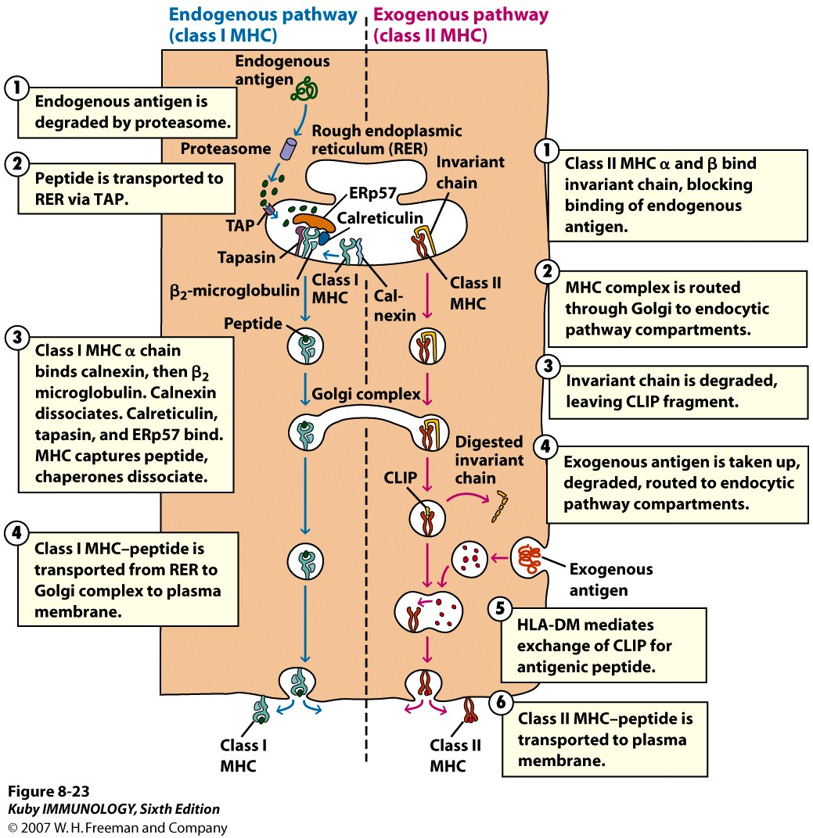
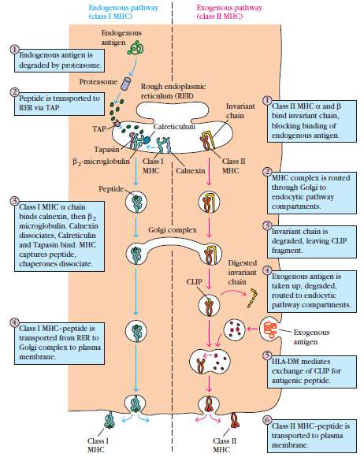
fndob"t'llOUS p:ithV.'I\' I
Ccbss I\tf-1() :
I I I I I I
Exogenous r:uh\\ Jiv
Cd1ls ll 1\tlfC)
I
Rnusfl cndoplasmk
retil:ulum(REIO
ln''l.liutt
c:: -,d( uin
Cb. lJ_ tHC a :LOd p
hind in\"'lri.unduin., hlockiag binding or codogc-oousan1igen.
P2·n•krog.lobulin 1
"--J"-"'<"---
l Cb.ss n
_!.1HC
Tapasio
.MllC ICalnc'.rin
Cills.I
2
I
',,'
.
1HC cocuptc:x is routed tluough C.Olgi to cndocyuc: pat:hwar cootpinmc:n:Ls.
i'<:plkk
(.Ch-s J UICn-d-:u-i- n---,
\QJJ
binds calncxio. then p::
I I I
Gul!gi complex
miaoglobubn. Ctlnexio
dWocia.tts. Calreticulio
and Tapasin bind. lHC capturespcpli&,
du p<:run csdi:sMK:"'ia1c.
ln 'lrilru chainis dqvaded,ka\ing OJJ> fr.igman.
I
I
Digdtcd
iovari:utt r fI-O-O'->gcAO... ..;., -
CLTP
dWo •
@
bl= iq>.cJtsr.ldecl,
'» ruu1ed!loeu dOC\'lic
l
p:t.tbw:..-ycompaM:mcut<.;.
. .
@
_{l} \1[..b'
!
v '>
I1®t--
Ch!is 1"'1.lHC-pcptidc i" t.nnspoctcd fromRER to Golgi campier toplasma mc:mbr.wc.
l:lL.\·O t mcdi:u..e.l'
achange ( f WJ> for
tigcn.it peptide.
/
Cb.o;s J
1MC
/
Ollso; O
MHC
ci:ass n ritH\.-pcplidc is tnlllspon.edtopbt.'ilm mcmbr2ne.

Slide 40
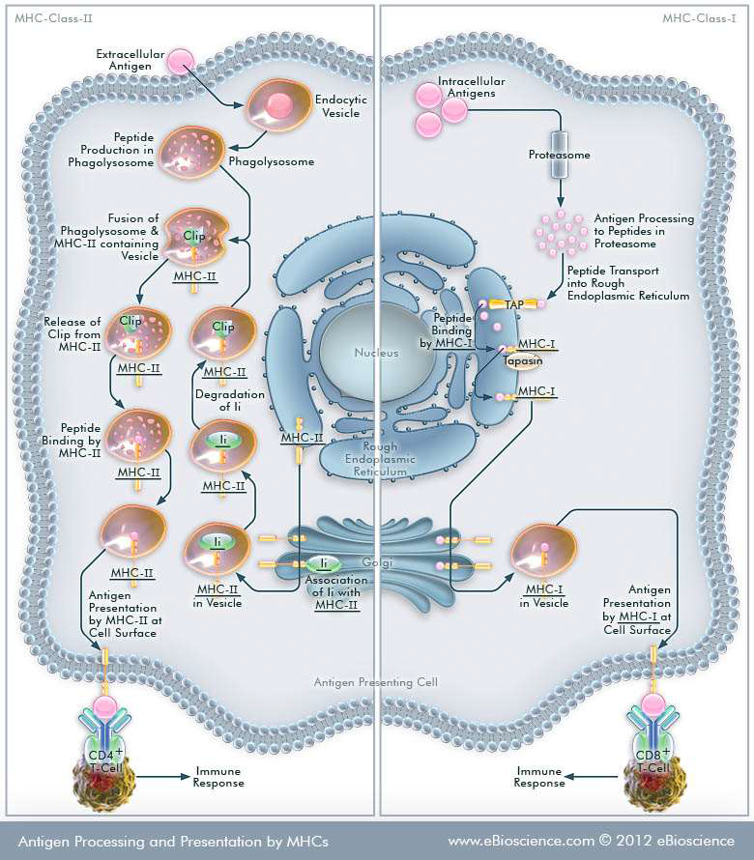
MHC Clou-Il
MHC-Closs-J
lntrocelfulor
Antigent
Peptide Production in Phogolysosome
1
Proteosome
Fusion of
Antigen Processing
lo Peptides in
Protea.some
Phogolysosoi:n! &
Cli
MHC.n conto1n1n9
- ._.
Vesi
(
Peptide T•onsport
₎ into Rough Endoplasmic Reticulum
MHC-JJ
r
MHC-JJ
egrodoh.on
of Ii
...!!...
MHC-I
in v.,;c1.
II
Antigen .PrrA- nhng c.11
Anhgen Processing and Presentation by MHCs
www.eBioscience.com «:> 2012 eB1oscience

