Slide 1
Psychosomatic and somatoform disorder
Psychiatry department
Beni Suef University

Slide 2
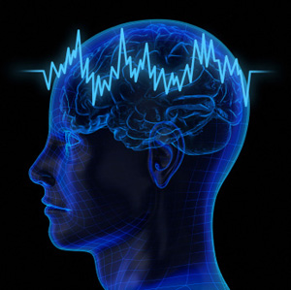
Psychosomatic Disorders
Psychosomatic medicine deals with the relation between psychological and physiological factors in the causation or maintenance of disease states.

Slide 3
Psychosomatic Disorders
Most physical disorders are influenced by stress, conflict, or generalized anxiety.
However, a psychosomatic disorder is considered if psychological factors have influenced the course of the general medical condition.

Slide 4
Etiology of Psychosomatic Disorders
1. Specific stress factors:
a. Certain personality traits
b. Specific types of unconscious conflicts that produce anxiety
2. Non-specific stress factors:
Each person has a target organ that is genetically vulnerable to stress.
3. Physiological factors:
HPA axis is secreting excess cortisol thus producing structural damage to various organ systems.
4. Neurophysiologic pathways

Slide 5
Some clinical presentations of Psychosomatic Disorders
1. Skin: Neurodermatitis & alopecia areata.
2. Musculoskeletal system: Backache, myalgias and tension headaches.
3. Respiratory system: Bronchial asthma and hiccough.
4.Cardiovascular system: Paroxysmal tachycardia, essential hypertension, migraine, and coronary artery diseases.

Slide 6
Some clinical presentations of Psychosomatic Disorders
5.Gastrointestinal system: Heartburn, peptic ulcer, constipation, ulcerative colitis and spastic colon.
6. Genitourinary system: Disturbances in menstruation and micturition, dyspareunia and impotence.
7. Special senses: Tinnitus or blurring of vision.
8. Immune system: Lupus Erythematosus, Rheumatoid Arthritis.
9. Endocrinal system: Thyrotoxicosis, Diabetes Mellitus.

Slide 7
Management of Psychosomatic Disorders
* Mild cases could be handled by the patient's own general practitioner, physician or surgeon
* Simple reassurance may be of value in early cases.
* Undue investigations may fix the symptoms.
* Some medications such as minor tranquilizers may give some relief but are liable to induce addiction.

Slide 8
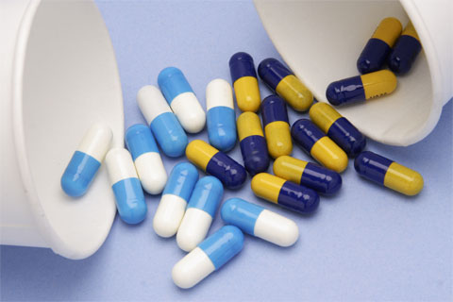
Management of Psychosomatic Disorders
* The behavioral approach includes desensitization;
biofeedback techniques are also partially included in cognitive therapy.
* Autonomic blockers (as Beta blockers) are also useful and they could be helpful to cut the vicious circle of autonomic arousal.
* Underlying psychiatric disorders need to be treated promptly, e.g., giving antidepressants for depression.

Slide 9
Somatoform Disorders
Somatoform disorders have in common the presence of one or more physical complaints for which an adequate physical explanation cannot he found.
There is usually an absence of findings or only minor findings on physical or laboratory examination together with exaggerated complaints.

Slide 10
Somatization Disorder
Somatization disorder is a chronic syndrome of multiple somatic symptoms that cannot be explained medically and is associated with psychosocial distress and medical help-seeking.
It requires a history of several years duration, beginning before the age of 30.

Slide 11
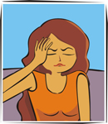
Epidemiology of Somatization Disorder
* lifetime prevalence is 0.2 - 0.4%.
* 5-20 times more common in women than in men.
* common in illiterates with low socio-economic classes.
* It runs in families.

Slide 12
Etiology of Somatization Disorder
* Identifying with a parent with somatization disorder.
* Cognitive impairment that result in faulty perception of somatosensory input.
Alexithymia

Slide 13
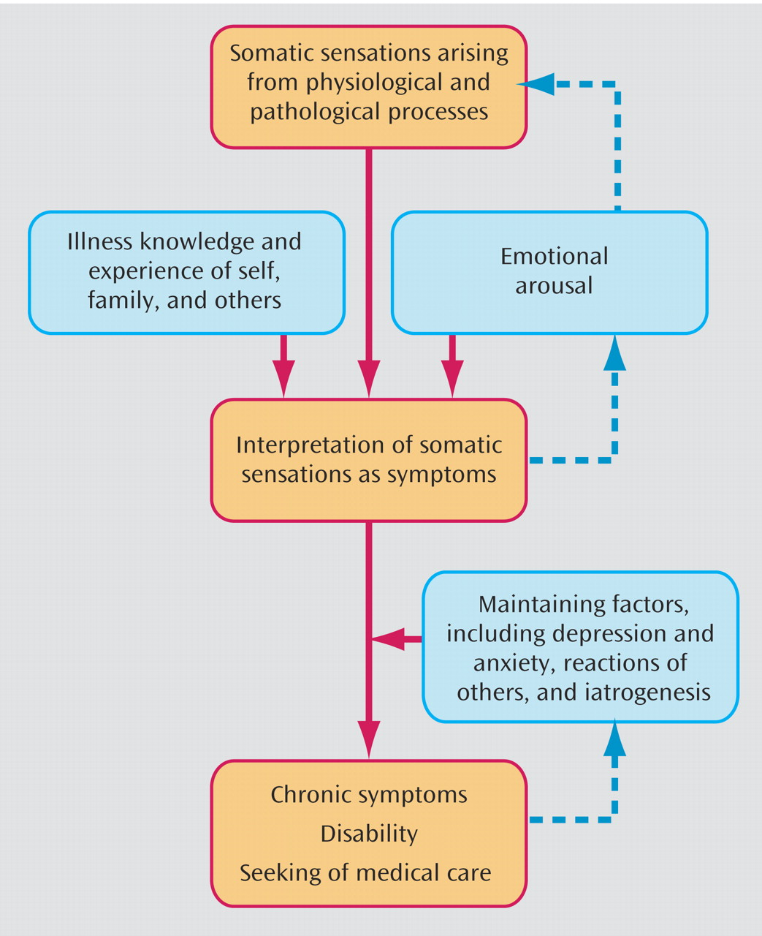

Slide 14
Clinical Picture of Somatization Disorder
Patients with somatization disorder have a multitude of somatic complaints.
The symptoms have no organic pathology of pathophysiological mechanism.
When there is related organic pathology, the complaint is grossly in excess of what would be expected from the physical findings.

Slide 15
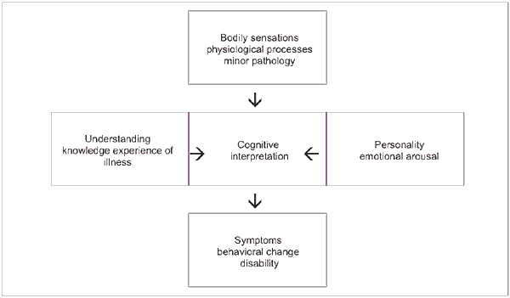

Slide 16
Clinical Picture
Symptoms may involve:
1.Gastrointestinal
2. Pain
3. Cardiopulmonary
4. Conversion or pseudo-neurological
5. Sexual

Slide 17
Course and prognosis of Somatization Disorder
* It puts high burden and costs on the mental health services,
As patients do frequent visits to physicians and repeat costly investigations and are not convinced with the same negative results.
* It is a chronic illness that runs a fluctuating course.

Slide 18
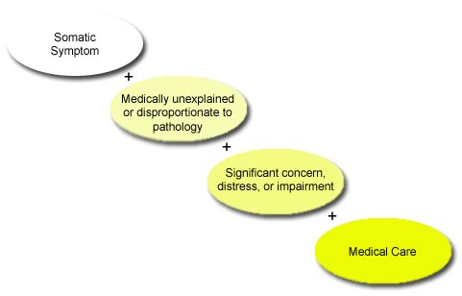

Slide 19
Treatment of Somatization Disorder
* Long term empathic relationship with a single physician is needed.
* Avoid prescribing unneeded analgesics or psychotropic medication
• Behavioral cognitive psychotherapy.

Slide 20
Thank You

