Slide 1
Osteoporosis
Ahmed Yehia, MD

Slide 2
Pretest
Osteoporosis is more painful than osteoarthritis.
Osteoporosis can’t be diagnosed by x-ray.
Osteoporosis is mainly treated by calcium & vitamin D.
Osteoporosis is more common in females.
Osteoporosis is a disease of the elderly only.

Slide 3
Metabolic bone disease
-- mineralization
-- protein matrix (osteoid)
Children →
Rickets
Adult →
OsteoMalacia
Osteoporosis

Slide 4
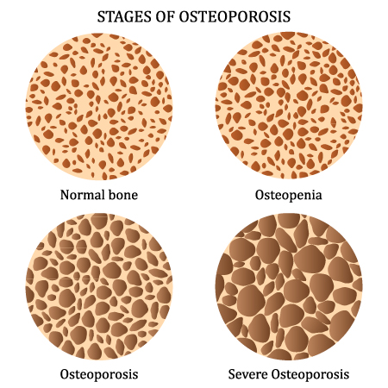
Osteo-por-osis

Slide 5
What is osteoporosis?
A systemic skeletal disease involving low bone mass and microarchitectural deterioration of bone tissue, resulting in increased bone fragility and consequent increased fracture risk.

Slide 6
Pathophysiology

Slide 7
Imbalance between bone resorption & formation causes loss of bone substance.

Slide 9
Causes and Risk Factors

Slide 11
Diagnosis

Slide 12
Clinical Presentation I. History
Osteoporosis is asymptomatic in absence of a fracture; it is usually diagnosed on routine screening or after a fracture occurs.

Slide 13
fracture
Fragility
History of fracture with minimal trauma (eg, ground-level fall) is strongly suggestive of osteoporosis.
Vertebral fractures are the most common form of osteoporotic fracture
New vertebral fractures, even those not recognized clinically, are associated with substantial increases in back pain & functional limitation therefrom, at least in elderly women.
Patients often present after a fall or a spinal flexion-loading event in which they may hear a “pop” & complain of sharp midline back pain, possibly radiating to the flanks.
Patients may also present with back “tiredness,” which improves when they sit or lie down.
Hip fractures are also common & generally occur with falls, although these fractures rarely may occur with limited force such as twisting.
National Osteoporosis Foundation considers fractures of the spine, proximal femur, distal forearm & proximal humerus to be major osteoporotic fractures.

Slide 14
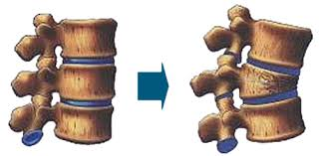
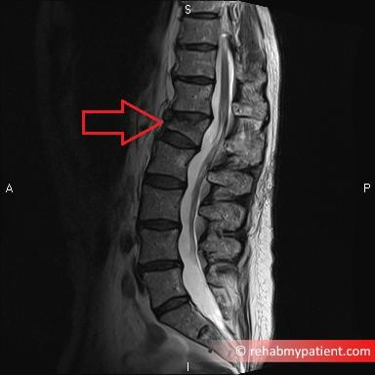
Wedge Fracture to the Vertebra

Slide 15
Physical examination
Complete examination of the spine includes measurement of height & assessment of pain, paraspinal muscle contraction, thoracic kyphosis, lumbar lordosis, scoliosis & the gap between the costal margin & iliac crest; also evaluate for the abdominal protrusion that can occur with multiple vertebral fractures
A kyphotic deformity of the upper thoracic spine may be present; it is important to distinguish it from accentuated cervical lordosis with associated prominence of T1.
Measured height loss > 4 cm since young adult maximum height is suggestive of prior vertebral fractures; it is best measured with a calibrated device such as a stadiometer.
Height loss also occurs with scoliosis & aging (approximately 0.8 cm of height is lost each decade after age 50 years).
Acute vertebral compression fracture can cause spinal tenderness to palpation & percussion.
Underlying processes contributing to secondary osteoporosis.

Slide 16
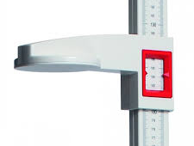
Stadiometer

Slide 18
Imaging
X-ray
DEXA
CT

Slide 19
Notes:
Classification
Defined operationally on the level of bone mass, measured as bone mineral density ²
WHO criteria for classification of osteopenia and osteoporosis ⁹
Normal: bone mineral density 1 standard deviation or less below that of young white women reference mean (ie, t score −1 or greater)
Osteopenia: bone mineral density between 1 and 2.5 standard deviations below that of young white women reference mean (ie, t score between −1 and −2.5)
Osteoporosis: bone mineral density more than 2.5 standard deviations below that of young white women reference mean (ie, t score less than −2.5)
Within the category of osteoporosis, WHO has defined 2 thresholds of bone mineral density, on the basis of the relationship of fracture risk to bone mineral density: ²
Osteoporosis
Bone mineral density that is 2.5 standard deviations or more below the young adult mean for women (ie, t score of −2.5 or less)
Severe or established osteoporosis
Osteoporosis by aforementioned definition (t score of −2.5 or less) plus 1 or more documented fragility fractures
Osteoporosis can also be defined clinically based on low bone mineral density (osteopenia) that is between 1.1 and 2.4 standard deviations below that of the young adult mean for women (ie, t score between −1.1 and −2.4) in a person who has had a fragility fracture

Slide 20
Management
Preventive
Therapeutic

Slide 21
Prevention

Slide 22
Restoring the balance between bone resorption & formation causes loss of bone substance

Slide 23
• Vitamin D and calcium.
• SERMs: Raloxifene.
• Bisphosphonates: Alendronate, risedronate.
• Human recombinant PTH: Teriparatide.
• Calcitonin.
• Discontinue glucocorticoid (if osteoporosis due to chronic use).
• Surgical stabilization of fractures: Kyphoplasty/vertebroplasty for spinal fractures; ORIF for fractures of the hip or wrist.

Slide 24
Posttest
Osteoporosis is more painful than osteoarthritis.
Osteoporosis can’t be diagnosed by x-ray.
Osteoporosis is mainly treated by calcium & vitamin D.
Osteoporosis is more common in females.
Osteoporosis is a disease of the elderly only.

Slide 25
Key Points
Osteoporosis is a systemic skeletal disease involving low bone mass and microarchitectural deterioration of bone tissue, resulting in increased bone fragility and consequent increased fracture risk 1
Defined as bone mineral density that is 2.5 standard deviations or more below the young adult mean for women (ie, t score of −2.5 or less) 2
History of fragility fracture is strongly suggestive of osteoporosis 3
60% of women with osteoporosis will experience 1 or more fragility fractures 1
Most common clinical form of osteoporosis is postmenopausal 1
Bone mineral density test results determine whether a patient has normal bone density, osteopenia, osteoporosis, or severe osteoporosis; WHO and the International Osteoporosis Foundation recommend that reference technology for diagnosis of osteoporosis is DEXA applied to the femoral neck 2
Lifestyle measures to improve bone health include increasing physical activity, reducing fall risk, ensuring proper nutritional status with adequate calcium and vitamin D intake (preferably through diet rather than supplements), stopping smoking, and moderating alcohol intake 2 3
American College of Physicians recommends that clinicians offer pharmacologic treatment with alendronate, risedronate, zoledronic acid, or denosumab to reduce the risk for hip and vertebral fractures in women with known osteoporosis 4
American College of Physicians recommends that clinicians offer pharmacologic treatment with bisphosphonates to reduce the risk for vertebral fracture in men who have clinically recognized osteoporosis 4
American College of Physicians recommends against using menopausal estrogen therapy, menopausal estrogen plus progestogen therapy, or raloxifene to treat osteoporosis in women 4
Complications include fractures of hip (femoral neck), vertebrae, wrist, pelvis, and other bones 1
Osteoporosis is associated with mortality; for each standard deviation decrease in bone mineral density, mortality risk increases 1.17-fold; 5 evidence suggests a statistically significant reduction in death with pharmacologic treatment of osteoporosis 3
American College of Preventive Medicine recommends that the following patients be screened for osteoporosis with bone mineral density testing: women aged 65 years or older; men aged 70 years or older; postmenopausal women; women with hormonal, vitamin, or calcium concentrations outside reference range; and patients with a personal or family history of previous fractures or conditions associated with bone loss 6

Slide 26
Pitfalls
Hormone replacement therapy is no longer recommended to treat osteoporosis; American College of Physicians recommends against using menopausal estrogen therapy, menopausal estrogen plus progestogen therapy, or raloxifene to treat osteoporosis in women 4
Among women with breast cancer or history thereof, avoid estrogen, progesterone, and selective estrogen receptor modulators in those with hormone receptor–positive disease 7

