Slide 1
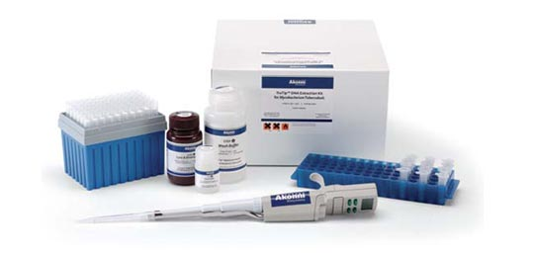
DNA EXTRACTION
Prof.Dr. Khadiga Abougabal
Clinical & Chemical Pathology Department
Faculty of Medicine
Beni-Suef University

Slide 2
Intended Use
The Large Fragment DNA Extraction Kit provides a streamlined method for the rapid purification and concentration of high-quality large-sized DNA from agarose gels. Simply add the specially formulated Agarose Dissolving Buffer (ADB) to the gel slice containing a DNA sample, let dissolve, and then transfer to the supplied DNA Binding Column. There is no need for organic denaturants or chloroform. Instead, the product utilizes unique spin column technology to yield high-quality, purified DNA in just minutes. DNA purified using the Large Fragment DNA Extraction Kit is ideal for PCR, sequencing, endonuclease digestion, ligation, etc. The entire procedure typically takes about 15 minutes.

Slide 3
Specifications
DNA Purity: High-quality, purified DNA is especially well suited for sequencing and ligation reactions.
DNA Size Limits: From ~50 bp to >200 kb.
DNA Recovery: Typically, up to 10 µg total DNA per column can be eluted into ≥ 10 µL of low salt DNA Elution Buffer or water. Recovery of DNA ranges from 70-95%.
Sample Sources: DNA in excised agarose gel slices.
Product Detergent Tolerance: ≤ 5% Triton X-100, ≤ 5% Tween-20, ≤ 5% Sarkosyl, ≤ 0.1% SDS

Slide 4
Materials Supplied
List of component
Component 25 Reactions 100 Reactions
Agarose Dissolving Buffer
(ADB) 50 mL 100 mL
DNA Wash Buffer* 6 mL 24 mL
DNA Elution Buffer 1 mL 4 mL
DNA Binding Columns 25 tubes 100 tubes
Collection Tubes 50 tubes 200 plates
* Ethanol must be added prior to use as indicated on the DNA Wash Buffer label.

Slide 5
Storage Instruction
Component Storage Information
Agarose Dissolving Buffer (ADB) Room temperature DNA Wash Buffer Room temperature DNA Elution Buffer Room temperature DNA Binding Columns Room temperature Collection Tubes Room temperature

Slide 6
Materials Required but Not Supplied
100% ethanol or 95% ethanol

Slide 7
Assay Protocol
Reagent Preparation
Before starting:
✓ Add 24 mL 100% ethanol (26 mL 95% ethanol) to the 6 mL DNA Wash Buffer concentrate.
✓ Add 96 mL 100% ethanol (104 mL 95% ethanol) to the 24 mL DNA Wash Buffer concentrate

Slide 8
Assay Procedure
All centrifugation steps should be performed between
11,000 - 16,000 x g.
Excise the DNA fragment from the agarose gel using a razor blade or scalpel and transfer it to a 1.5 mL microcentrifuge tube. Note: The amount of agarose excised from the gel should be as small as possible.
Add 3 volumes of ADB to each volume of agarose excised from the gel (e.g. for 100 µL (mg) of agarose gel slice add 300 µL of ADB).
3. Incubate at 37-55°C for 5-10 minutes until the gel slice is completely dissolved. Note: Do not incubate above 60°C. It is important that the gel slice dissolves completely. This can be facilitated by gentle mixing during the incubation.
4. Transfer the melted agarose solutions to a DNA Binding Column in a Collection Tube. 5.

Slide 9
5. Centrifuge for 1 minute. Discard the flow-through. Note: Remove the flow-through by aspiration. Avoid contamination of the Collection Tube rim.
6. Add 200 µL of DNA Wash Buffer to the column and centrifuge for 30 seconds. Discard the flow-through. Repeat the wash step.
7. Add ≥10 µL DNA Elution Buffer or water directly to the column matrix and wait for 1 minute. Place column into a 1.5 mL tube and centrifuge for 30 seconds to elute DNA. Ultra-pure DNA is now ready for use. Note 1: DNA Elution Buffer: 10 mM Tris-HCl, pH 8.5, 0.1 mM EDTA. Note 2: Elution of DNA from the column is dependent on pH and temperature. If water is used, make sure the pH is >6.0. The total yield may be improved by eluting the DNA with 60-70°C DNA Elution Buffer

Slide 10
Resources
Troubleshooting
✓ Low Recovery
• Ensure Agarose is Fully Dissolved There may be small globules of undissolved agarose in the sample, containing DNA inaccessible for recovery. Undissolved agarose can also inhibit DNA recovery by clogging the column and leeching salts into the eluate.
• Gel Dissolved at Temperatures Above 60 °C If dissolved at a higher temperature, DNA may be denatured affecting recovery. For optimal results, dissolve the gel slice between 37-55 °C.
• Improperly Prepared/Stored DNA Wash Buffer Make sure ethanol has been added to the DNA Wash Buffer concentrate. Cap the bottle tightly to prevent evaporation over time.
• Addition of DNA Elution Buffer Add elution buffer directly to the column matrix, not to the walls of the column. Elution buffer requires contact with the matrix for at least 1 minute for large DNA ≥ 10kb.

Slide 11
Incomplete Elution
DNA elution is dependent on pH, temperature, and time. For large genomic DNA (≥ 50 kb), apply heated elution buffer (60-70 °C) to the column and incubate for several minutes prior to elution.
2. Sequential elusions may be performed for quantitatively higher recovery but lower final DNA concentration. This is recommended for DNA ≥ 10 kb.
✓ Low A260/A230 ratio
• Column tip contaminated When removing the column from the collection tube, be careful that the tip of the column does not come into contact with the flow through. Trace amounts of salt from the flow through can contaminate a sample resulting in a low A 260 /A 230 ratio. Ethanol contamination from the flow through can also interfere with DNA elution. The DNA Binding Columns are designed for complete elution with no buffer retention or carryover.

Slide 12
✓ Following Clean-up, Multiple Bands Appear in an Agarose Gel
• Acidification of DNA Loading Dye :
Most loading dyes do not contain EDTA and will acidify (pH ≤ 4) over time due to some microbial growth. This low pH is enough to cause DNA degradation. Therefore, if water is used to elute the DNA, 6X Loading Dye containing 1 mM EDTA is recommended.

Slide 14
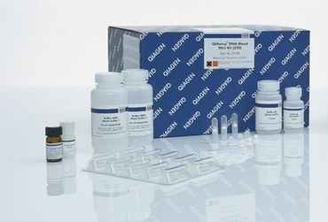

Slide 15
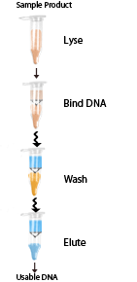
The actual process of DNA extraction follows the usual workflow of column-based DNA cleanups. Binding of DNA in high salt conditions to silica membranes, washing with Ethanol based wash buffers and elution in low salt conditions.
The DNA is extracted in a buffer which contains some Tris, no EDTA and is adjusted to a pH of 8.
You can choose the elution volume to be 100ul or 200ul.
The manual extraction time (excluding Prot K digestion) is about 20min per sample.

Slide 16
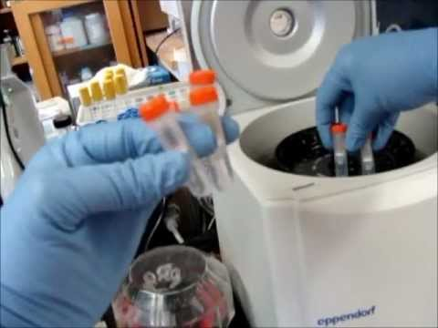

Slide 17
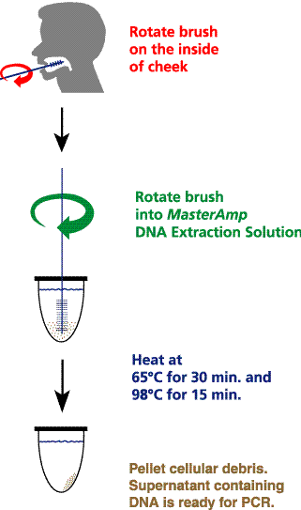

Slide 18
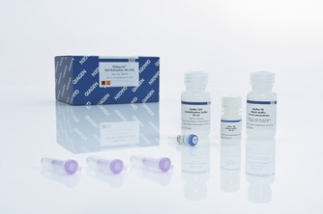
QIAquick Gel Extraction Kit
For gel extraction/cleanup of up to 10 μg DNA (70 bp to 10 kb) from enzymatic reactions
Up to 95% recovery of ready-to-use DNA
Fast and convenient procedure
Cleanup of DNA up to 10 kb in three easy steps
Gel loading dye for convenient sample analysis
The QIAquick Gel Extraction Kit provides spin columns, buffers, and collection tubes for silica-membrane-based purification of DNA fragments from gels (up to 400 mg slices) or enzymatic reactions. DNA ranging from 70 bp to 10 kb is purified using a simple and fast bind-wash-elute procedure and an elution volume of 30–50 μl. An integrated pH indicator allows easy determination of the optimal pH for DNA binding to the spin column. The procedure can be fully automated on the QIAcube.

Slide 19
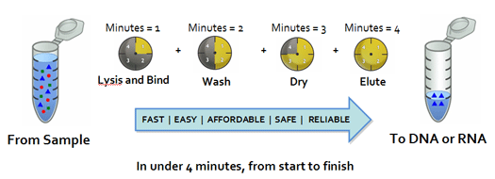

Slide 20
