Slide 1
Adjustment and mood disorders
Psychiatry department
Beni Suef University

Slide 2
Adjustment Disorders
Definition
* The development of emotional or behavioral symptoms in the context of identified psychosocial stressors.
* The resultant symptoms are clinically significant by virtue of either:
a. impairment in function
b. the subjective experience of excessive distress

Slide 3
Adjustment Disorders
* The symptoms must occur within 1-3 months of the occurrence of the stressor, and must remit within 6 months following the cessation of the stressor.
* The disturbance must not fulfill the criteria for another major psychiatric disorder.

Slide 4
Adjustment Disorders
Clinical Subtypes
1. Adjustment disorder with depressed mood
2. Adjustment disorder with anxiety
3. Adjustment disorder with disturbance of conduct
4. Adjustment disorder with disturbance of emotion and conduct

Slide 5
Adjustment Disorders
Epidemiology
* They are very common disorders.
* In a study conducted in the United States, 10 % had adjustment disorder.
* Male to female ratio is 1 to 2.

Slide 6
Adjustment Disorders
Treatment
* Symptomatic use of medication, e.g., antidepressants, anxiolytic agents.
* Supportive psychotherapy
* Family therapy to improve family support

Slide 7
Mood Disorders
Mood Disorders are a group of psychiatric disorders where a disturbance of mood is the salient feature.
The disturbance of mood may be in the form of low mood (depression) or high mood (elation).

Slide 8
Mood Disorders
The most common types are:
Depressive Disorders
Major Depressive Disorder
Dysthymic Disorder
Bipolar Disorders

Slide 9
1. Major Depressive Disorder (Unipolar depression)
Epidemiology
Sex: Twice in women than in men.
Age: Most commonly, its age at onset is 20-40 years.
Lifetime Prevalence: 5-12 % in males, and 10-25 % in females.
Annual Incidence: 1.5 % over the whole population.
Marital Status
Socio-economic Status

Slide 10
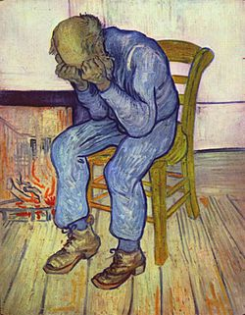
Etiology of depression
(A) Biological Factors:
1. Genetic Factors:
2. Neurochemical Factors:
3. Hormonal Factors:
(B) Psychosocial factors:
1. Early trauma in childhood
2. Negative Life Events
3. Chronic Stress

Slide 11
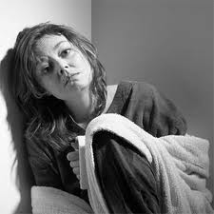
Major Depressive Disorder
Clinical Picture:
75 % of patients experience recurrences throughout life, with varying degrees of residual symptoms between episodes.
depressed mood or anhedonia for two weeks. The patient is typically worse in the morning (diurnal variation).

Slide 12
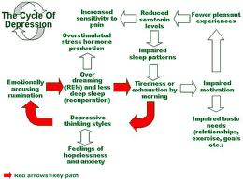

Slide 13
Other symptoms of major depression include:
1. Sleep disturbances
2. change of appetite
3. Loss of libido, impotence in males.
4. Psychomotor retardation
5. Tendency to social withdrawal.
6. Decline in vocational functioning.
7. Fatigue or loss of energy.
Cognitive misinterpretations
8. Diminished ability to think or concentrate.
9. Feeling of worthlessness
10. Excessive or inappropriate self-blame and guilt.
11. Recurrent thoughts about death
12. Diffuse bodily complaints,
13. Depersonalization and derealization.
psychotic features in the form of delusions and hallucinations may be present

Slide 14
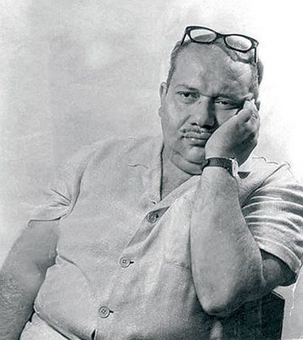
صلاح جاهين
يا حزين يا قمقم تحت بحر الضياع حزين أنا زيك و إيه مستطاع الحزن ما بقالهوش جلال يا جدع الحزن زي البرد ... زي الصداع عجبي

Slide 15
صلاح جاهين
عام*انا شاب لكن عمرى الف وحيد لكن بين ضلوعى زحام خايف لكن خوفى منى انا أخرس لكن قلبى مليان كلام عجبى!!!

Slide 16
Depression is a systemic illness
multiple disorders related to the immune system, (malignancies, susceptibility to infections)
Control of diabetes becomes difficult.
platelet aggregation and blood vessels (coronary ischemia).

Slide 17
The Economic and Social impact of Major Depression
Unipolar Depression was the "leading cause of disability" all over the world in the age range of 15-44 years (WHO, 2001).
It was the fourth leading cause of death in the same age range.
By the year 2020, with the increasing number of depressed patients, it will rank second on the list of causes of death after ischaemic heart disease.

Slide 18
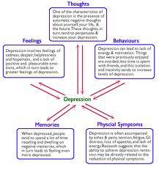

Slide 19
2. Dysthymic disorder (Depressive Neurosis)
It is a chronic depressive illness less severe than Major Depressive.
The onset is insidious and the course is chronic (more than 2 years). Its lifetime prevalence is 6 % of all people.
Age of onset is usually younger than in major depression.

Slide 20
2. Dysthymic disorder
Those with onset during childhood or adolescence have a greater risk to develop major depression later in life (Double Depression).
It is more common among the first degree relatives with major depression.

Slide 21
Clinical picture of Dysthymia
A persistent depressed mood for more than two years.
In addition, there are at least two of the following symptoms:
• Poor appetite or overeating.
• Sleep problems.
• Fatigue.
• Feeling of hopelessness and low self esteem.
• Poor concentration or difficulty making decisions.

Slide 22
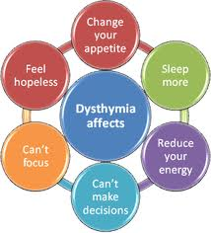

Slide 23
Treatment of Depressive disorders
1. Hospitalization
2. Pharmacotherapy:
3. Electro-Convulsive Therapy (ECT)
4. Psychotherapy

Slide 24
Pharmacotherapy:
* Tricyclic and tetracyclic antidepressants
* SSRIs and other more recent antidepressants
* Maintenance treatment should be continued for at least 6 month to prevent relapse.
* Long treatment is needed with chronic or recurrent major depression
* Lithium, Antipsychotics in small dose and Antiepileptics.

Slide 25
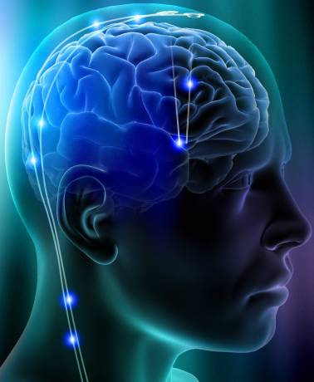
Electro-Convulsive Therapy (ECT)
is indicated in:
* Refractory Depression
* If it is associated with psychotic features
* Suicidal patients

Slide 26
Psychotherapy:
* Psychotherapy in conjunction with antidepressants
* Cognitive Therapy: Short term treatment aiming to correct the negative cognitive symptoms of depression.
* Supportive Psychotherapy: For emotional support, ventilation and reinforcement
* Family therapy: Indicated when patient's depression is disrupting family stability or related to family events.

Slide 27
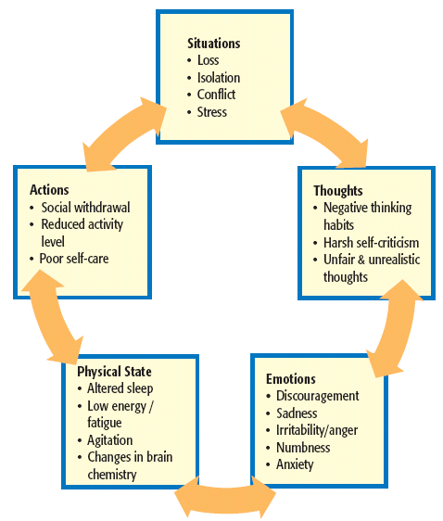

Slide 28
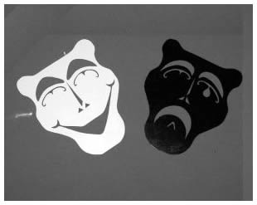
Bipolar Disorders
characterized by the recurrence of either manic or hypomanic episodes, with or without history of a major depressive episode.
There may be a mixed episode.
Bipolar Disorders occupy the 9th position in the list of "causes of disability" according to the WHO report in 2001.

Slide 29
A manic episode
consists of a distinct period of persistently
elevated, expansive, or irritable mood.
grandiose thinking,
decreased need for sleep,
volubility,
flight of ideas,
distractibility
increase in goal-directed activities.
hyperactive.
Excitement and aggressive behavior
There may be psychotic features

Slide 30
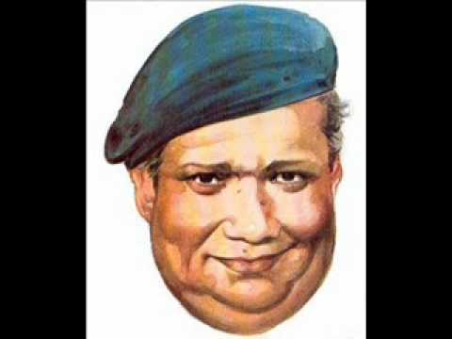
صلاح جاهين
للجمــــــــــــــــــال *إنشد يا قلبي غنوتك و ارقص في صدري من اليمين للشمال ما هوش بعيد تفضل لبكره سعيــــــــــد ده كل يوم فيه الف الف احتمـــــــــــــال عجبي !!

Slide 31
صلاح جاهين
مرحب ربيع مرحب ربيع مرحبــــــــــه يا طفل يا للي ف دمي ناغا وحبــــــــا علشان عيونك يا صغنن هويــــــــــــت حتي ديدان الأرض و الأغربــــــــــــــة عجبي !!! !!!!

Slide 32
A hypomanic episode
is similar to a manic episode, but the symptoms are not severe enough to cause marked deterioration in either social or occupational functioning.
Hospitalization is not required, and there are no psychotic features.

Slide 33
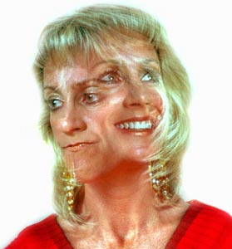
Epidemiology of Bipolar affective disorder
Lifetime Prevalence: 1 %
Sex: No difference between males and females.
Age at onset: Bipolar disorder occurs at any age, starting from childhood.
It typically has an earlier age of onset than major depression, with an average of 30 years.

Slide 34
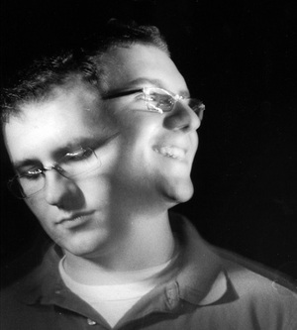
Etiology of BAD
Genetics: First-degree relatives of bipolar disorder are 8-18 more likely to have the disease compared to controls.
They are 2-10 more likely to have major depression.
Concordance rate for monozygotic twins is approximately 60 %, it is 15 % in dizygotic twins.
Stressor (Negative Life Events)
Substance Abuse: Adolescents who use cannabinoids are at risk at developing bipolar disorder.

Slide 35
Course and Prognosis of BAD
less favorable than that of major depression.
* 10 % of all patients have a single manic episode.
* 45 % have recurrent multiple episodes.
* Recurrence occurs within 2 years of the previous episode in 50 % of cases.
* 45 % have a chronic disorder with partial improvement on medication.

Slide 36
Management of BAD
* Hospitalization
• Pharmacological treatment
• ECT
• Prevention of relapses

Slide 37
Pharmacological treatment
1. Control of agitation by low-potency antipsychotics, e.g., chlorpromazine.
2. High-potency antipsychotics are needed to control psychotic features.
3. Mood stabilizers, e.g., lithium and antiepileptics.
4. Antidepressants are better avoided to prevent shifting the patient into Rapid Cycling Bipolar Disorder.

Slide 38
Prevention of relapses:
1. Prophylaxis by the use of mood stabilizers (lithium or anticonvulsants) for many years after the active episode has ended.
2. Therapeutic alliance with the patient and his family to monitor early signs of relapse in order to start treatment early in subsequent episodes.
3. Family education to inform the family about the nature of the illness and its management.

Slide 39
Thank you

