Slide 1
Dibetes in Ramadan
Ahmed Yehia

Slide 2
Get ready to Ramadan.

Slide 3
We must stay updated & evidence-based.

Slide 4
Physiology of Ramadan Fasting

Slide 5
Dear doctor,
What are fasting risks on my diabetes?
????

Slide 8
No food, no water, no medication

Slide 9
My first question
Dear doctor,
can I fast?
????

Slide 10
What are risk items for stratification?

Slide 12
IDF-DAR risk categories for patients with DM who fast during Ramadan

Slide 15
If patients insist on fasting then they should:
• Receive structured education
• Be followed by a qualified diabetes team
• Check their blood glucose regularly (SMBG)
• Adjust medication dose as per recommendations
• Be prepared to break the fast in case of hypo- or hyperglycaemia
• Be prepared to stop the fast in case of frequent hypo- or hyperglycaemia or worsening of other related medical

Slide 16
Summary
•• With the correct guidance, many people with diabetes can fast safely during
Ramadan but they must be under close supervision and be made aware of
the risks.
•• The risks associated with fasting include hypoglycaemia, hyperglycaemia, DKA,
dehydration and thrombosis; physicians must quantify the risks and stratify each
individual patient accordingly.
•• The new IDF-DAR risk stratification approach defines three risk categories: very
high, high and moderate/low.
•• Patients who fast against the advice provided by their HCPs should follow experts’ detailed guidance to avoid the development of serious complications.

Slide 17
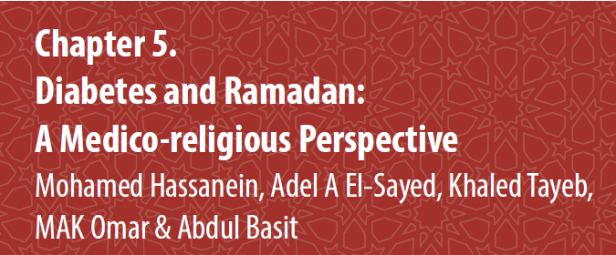

Slide 18
المرض و الصوم

Slide 19
أحكام الصوم مع المرض

Slide 20
Summary
•• Fasting during the month of Ramadan is a religious obligation for all healthy
adults. However, Islamic regulations have exempted those afflicted with illness
from this obligation.
•• Harmony between medical and religious advice is essential to ensure safe
fasting for people with diabetes. Indeed, the risk stratification groups defined in
these IDF-DAR Practical Guidelines have been endorsed by the highest religious
regulatory authority of Egypt.
•• HCPs, religious authorities, as well as people with diabetes, need to be made
aware of these regulations through all possible avenues.

Slide 22
Who should be educated?

Slide 23
فقه الصيام خاصة للمرضى فرض عين علينا.
Physicians
Fatwa leaders

Slide 27
When to break the fast???

Slide 28
Although rigorous exercise is not recommended during fasting because of the increased risk of hypoglycaemia and/or dehydration, patients with diabetes should be encouraged to take regular light-to-moderate exercise during Ramadan.
Patients should be reminded that the physical exertions involved in Tarawih prayers, such as bowing, kneeling and rising, should be considered part of their daily exercise activities.

Slide 29
Summary
•• Education is an essential component of diabetes management during Ramadan.
•• Programmes should be aimed at patients with diabetes, the HCPs who manage
them and the general public who support them.
•• A structured educational programme should include information on risk
quantification, blood glucose monitoring, diet, exercise, medication adjustments,
recognition of the symptoms of complications and when to break the fast to
prevent harm.
•• Studies have demonstrated a clear benefit of Ramadan-focused education
programmes in terms of glycaemic control, weight loss and a reduced risk of
hypoglycaemic events.
•• The positive outcomes of these programmes may also extend beyond the
month of fasting.

Slide 35
Summary
•• The RNP is a mobile and web-based application designed to help HCPs individualise and implement MNT for patients with diabetes during Ramadan. It also helps patients without access to HCPs to construct a healthy eating plan for Ramadan.
•• The RNP helps patients with diabetes to plan a daily caloric target that may help them to maintain body weight if they are lean, or to lose weight if they are overweight or obese.
•• Use of the RNP may help patients with diabetes to avoid risks during Ramadan
fasting, such as hypoglycaemia, hyperglycaemia and dehydration.
•• The RNP provides examples of meal plans within the target caloric levels, tailored
for use in different countries.
•• The RNP website is designed to capture menus from across the globe, that match
the structure provided in this chapter.

Slide 39
My question
Dear doctor,
can I stop drugs?
????

Slide 40
Metformin?

Slide 41
Pioglitazone

Slide 42
Repaglinide

Slide 43
SUs

Slide 44
SGLT2

Slide 45
DPP4

Slide 46
Insulin

Slide 50
Summary
•• A pre-Ramadan assessment is vital for any patient with diabetes who intends to
fast in order to evaluate the risks, educate the patient in self-management of the
condition during Ramadan and to produce a patient-specific treatment plan.
•• With the correct advice and support from HCPs most people with T2DM can fast
safely during Ramadan.
•• Patients taking metformin, short-acting insulin secretagogues, SUs or insulin
will need to make adjustments to dose and or timings to reduce the risk of
hypoglycaemia while maintaining good glycaemic control.
•• Newer OADs including incretin-based therapies are associated with a lower risk of
hypoglycaemia and may be preferable for use during Ramadan.
•• SGLT2 inhibitors are probably safe but should be used with caution in some
patients. More data regarding the use of SGLT2 inhibitors during Ramadan are
required.
•• Patients classified as very high/high risk including T1DM and pregnant women
with diabetes need close medical supervision and focused Ramadan-specific
education if they insist on fasting.
•• A post-Ramadan follow-up consultation is recommended.

Slide 51
Get ready to Ramadan.

