Slide 1
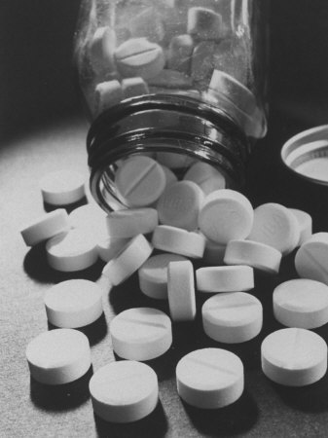
Pharmacotherapy
Psychiatry department
Beni Suef University

Slide 2
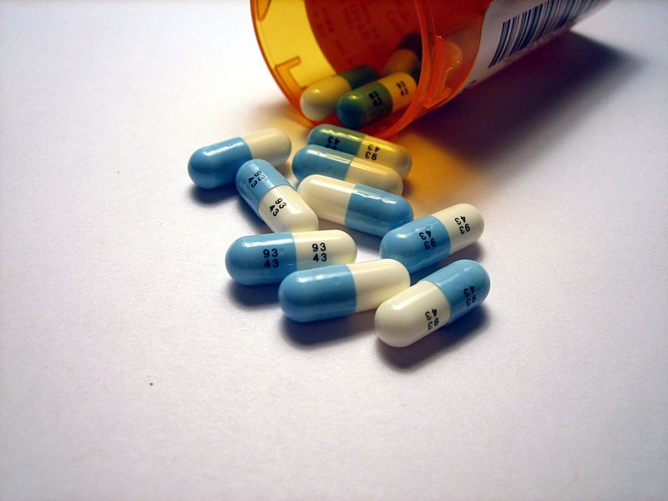
(A) Antipsychotics
They are classified into:
1- Dopamine receptors antagonists (Typical Antipsychotics).
2- Dopamine-serotonin receptors antagonists (Atypical Antipsychotics).

Slide 3
1. Typical Antipsychotics
They are D2 dopamine receptors antagonists. They are also called neuroleptics.
They are subdivided into:
High Potency Antipsychotics. e.g.. Haloperidol (Haldol, Safinace) tab 1.5 mg and 5 mg; and Trifluoperazine: Stelazine tab 5 mg.
Low Potency Antipsychotics, e.g., Chlorpromazine (Neurazine, Largactil) tab 25 and 100 mg.

Slide 4
1. Typical Antipsychotics
Mechanism of action
• Blockage of D2 receptors in mesolimbic mesocortical and tubuloinfudibular tracts.
• Blockage of histamine, cholinergic and noradrenergic receptors.

Slide 5
1. Typical Antipsychotics
Indications
Schizophrenia and other primary psychoses such as schizoaffective disorder, delusional disorder and
Bipolar disorders.
Psychotic symptoms in association with major depression
Psychotic disorders secondary to organic mental disorders
To control behavioral symptoms in association with childhood conditions such as autism and mental retardation.
In small doses, they are used to control generalized anxiety and psychosomatic disorders

Slide 6
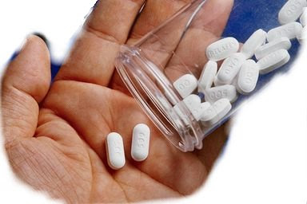
Adverse effects of typical antipsychotics
Neurological side-effects
Acute dystonic reaction (emergency)
Parkinsonian-like side effects
Akasthisia (emergency)
Tardive Dyskinesia (serious)
Non-Neurological Side-Effects:

Slide 7
Acute dystonic reaction
It is a severe spastic contraction in a group of muscles
It may occur after a single dose of the drug.
It occurs in 10% of cases.
It occurs in the form of occulogyric crisis, torticollis. protrusion of the tongue and laryngeal dystonia (most serious).
It is treated by injection of anticholinergic, antihistaminic drugs, or by benzodiazepines (Valium).

Slide 8
b. Parkinsonian-like side effects:
Due to blockade of D2 receptors in the basal ganglia
They occur in 15% of cases
It occurs in the form of rigidity, bradykinesia, and tremors.
It is treated by the addition of oral anticholinergic drugs.

Slide 9
c. Akasthisia (emergency):
It is a subjective feeling of muscle discomfort causing the patient to be restless. He keeps on moving without feeling anxious.
It occurs at any time in the course of treatment.
It is treated by
decreasing the antipsychotic drug to the least needed dose.
Propranolol and benzodiazepine are added to control it.

Slide 10
d. Tardive Dyskinesia
It occurs after prolonged use of typical antipsychotics,
Most commonly with high potency drugs. It is much less common in atypical antipsychotics.
It presents with abnormal involuntary movements mainly in the face, mouth and tongue.
Treatments: Stop drug and switch to atypical antipsychotics, particularly clozapine.

Slide 11
e. Neuroleptic malignant syndrome (emergency):
It occurs at any time during the course of treatment.
It is more common with high potency antipsychotics, particularly if high doses are introduced quickly in.
It is more common in hot weather
Characterised by increasing fever without apparent cause, muscle rigidity, and tachycardia.

Slide 12
e. Neuroleptic malignant syndrome (emergency):
Disturbance of conscious rapidly occurs. It progresses to coma if not treated.
Death may occur due to acute renal failure (due to muscle necrosis), or acute heart failure due to exhaustion.
CPK more than 1000 units.
Treated by stoppage of the drug, monitor of vital signs, monitor of renal functions, cold compresses (bath), beta- blockers, D2 dopamine agonists (bromocriptine) and direct muscle relaxants (dantrolene).

Slide 13
Non-Neurological Side-Effects:
a. Anticholinergic side effects as dryness of mouth, blurring of vision, hot flushes, constipation and urine retention. Cognitive functions dependent on cholinergic pathways are also affected. This leads to defective memory and concentration.
b. Cardiac as arrhythmia (anticholinergic effect).
c. Orthostatic hypotension.
d. Weight gain (antihistaminic effect).
e. Convulsions (lowering epileptic threshold).
f. Impotence and amenorrhea (due to increased prolactin).

Slide 14
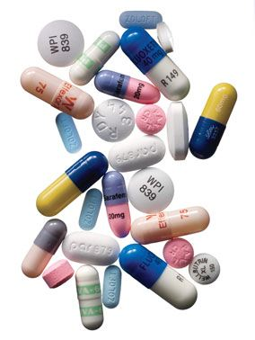
2- Atypical Antipsychotics:
They are more selective dopamine-serotonin receptors antagonists.
They have the same indications as the typical antipsychotics.
They usually cause much less of the side-effects observed with the typical antipsychotics. Moreover, they have the advantage of improving the negative symptoms of schizophrenia.
Examples:
a- Clozapine: Leponex tab. 25 and 100 mg.
b- Olanzapine: Zyprexa tab. 5 and 10 mg.
c- Risperidone: Risperidal tab. 2 and 4 mg.

Slide 15
(B) Antidepressants

Slide 16
(B) Antidepressants
Tricyclic and Tetracyclic Antidepressants.
Selective Serotonin Reuptake Inhibitors - SSRIs
Selective Serotonin Norepinephrine Reuptake Inhibitors (SNRI)
Noradrenergic & Specific Serotonergic Antidepressant (NASSA)
Norepinephrine &Dopamine Reuptake Inhibitors (NDRI)

Slide 17
Tricyclic and Tetracyclic Antidepressants
These drugs exert their antidepressant effect through the reuptake inhibition of norepinephrine (NE) and serotonin (5-HT), resulting in increased NE and 5-HT in the synaptic cleft.

Slide 18
Tricyclic and Tetracyclic Antidepressants
Examples of Tricyclic antidepressants are:
a- Imipramine: tofranil tab. 10 and 25 mg
b- Clomipramine: anafranil tab. 25 and 75 mg
c- Amitryptiline: tryptizol tab. 25 mg
The effective dose in Major Depression is 100-300 mg/day.
For other indications, a lower dose may be used.

Slide 19
Indications of TCA
1- Depressive disorders
2- In addition to antipsychotics in schizoaffective disorder depressive type.
3- Anxiety disorders as obsessive compulsive disorder
(clomipramine), panic disorder, and different types of phobias
4- Sleep disorders in children as nightmares (amitryptiline)
5- Nocturnal enuresis (imipramine)
6- Some sexual disorders as premature ejaculation (clomipramine)

Slide 20
Adverse effects:
Common side-effects include the following:
1-Anticholinergic side effects
2- Central Alpha-1 adrenergic effects
3-Anti-histaminic effects
4- Sexual side effects
5- Seizures: especially in epileptic patients.
6- Cardiac Side-effects
7- Exacerbation of manic episode in bipolar patients.
8- Exacerbation of psychotic episode in predisposed patients.

Slide 21
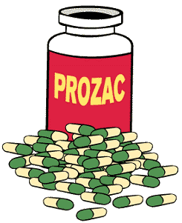
Selective Serotonin Reuptake Inhibitors - SSRIs
Their side effects are much less than tricyclic and tetracyclic antidepressants.
This group includes the following members:
1- Fluoxetine: Prozac capsules 20 mg
2- Fluvoxamine: Faverin tab 50 and 100 mg
3- Citalopram: Cipram tab. 20 mg
4- Sertraline: Lustral tab. 50 mg
5- Paroxetine: Seroxat tab. 20 mg

Slide 22
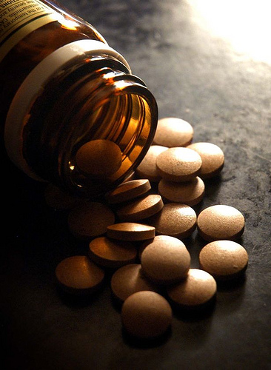
Indications of ssri
1- Depressive disorders
2- In addition to antipsychotics in schizoaffective disorder depressive type.
3- Anxiety disorders: SSRIs are the treatment of choice in obsessive compulsive disorder, panic disorder, and different types of phobias
4- Some sexual disorders as premature ejaculation
5- Eating disorders, particularly bulimia nervosa

Slide 23
Adverse effects of ssri:
1- GIT: anorexia, nausea, and vomiting, in the initial phase of treatment
2- Headache, anxiety, disturbed sleep continuity and irritability, in the initial phase of treatment
3- Sexual: delayed ejaculation, anorgasmia and impotence
4- Seizures. in susceptible patients, particularly with fluoxetine

Slide 24
Other Newer Antidepressants
Examples:
a- Venlafaxine: Efexor tab. 37.5 and 75 mg.
b- Mirtazepine: Remeron tab. 30 mg.

Slide 25
(C) Mood stabilizers
1- Lithium salts: Lithium carbonate (Prianel) tab. 400mg
2- Some Conventional Antiepileptics:
a. Sodium valproate: Depakine tab. 200 and 500 mg
b. Carbamazepine: Tegretol tab. 200 and 400 mg
3- Some Novel Antiepileptics:
a. Lamotrigine: Lamictal tab. 25 mg and 100 mg
b. Topiramate: Topamax tab. 25 mg and 100 mg
c. Gabapentine: Neurontine caps. 400 mg

Slide 26
Lithium Salts:
Lithium is a monovalent ion. It is not metabolized by the liver, and is excreted by the kidneys.
Indications
1- Bipolar Disorders
2- Schizoaffective Disorder - bipolar type.
3- Major depression (for resistant cases).
4- Resistant schizophrenia.
5- Aggressive behavior in mental retardation and dementia.

Slide 27
Adverse effects of lithium
1- GIT: nausea, vomiting, and diarrhea (in the initial phase of treatment)
2- Tremors
3- Polyuria (diabetes insipidus): It occurs due to inhibition of ADH that leads to decreased re-absorption of fluids. It is treated by fluids and K. retaining diuretics.
4- Thyroid effect: decrease of thyroid hormone, goiter in 5% of cases
5- Cardiac effect: manifestations of hypokalemia in ECG
6- Epilepsy in susceptible patients
7- Teratogenicity in pregnant patients

Slide 28
Lithium toxicity (emergency)
Early signs include nausea, diarrhea, polyuria, ataxia, and tremors.
Signs of severe toxicity are renal failure, ataxia, convulsions, delirium, and coma.
Death can occur due to dehydration, cardiac side-effects and neurotoxicity.

Slide 29
Lithium toxicity (emergency)
It is treated by:
a- Stoppage of the drug.
b- Monitoring and support of vital signs.
c- Neurological and mental status examination.
d- ECG, renal functions, electrolytes and serum lithium level assessment.
e- Hydration and restoration of electrolyte balance.
f- Heamodialysis if lithium level is more than 4 mEq / litter.

Slide 30
Serum level monitoring
Assessment of the serum level of lithium must be done regularly.
The first sample can be taken after 5 days of treatment, then every month after stabilization of the level.
The blood sample is collected 8-12 hours after the last dose.

Slide 31
Sodium Valproate
Indications
In bipolar disorders, sodium valproate is similar to lithium. However. it is preferred in the mixed and rapid cycling bipolar episodes.
Adverse effects
1- GIT: nausea, and vomiting
2- Sedation and tremors
3- Hepatotoxicity especially if used in children (<2 years).
4- Hair loss and weight gain.
5- Neural tube defect if used during pregnancy.

Slide 32
Carbamazepine
Indications
They are similar to lithium and sodium valproate. In addition, it is useful for the treatment of alcohol and benzodiazepine withdrawal.
Adverse effects
1- GIT: nausea, and vomiting.
2- Sedation, memory disturbance.
3- Elevate liver enzymes.
4- Hypersensitivity reactions, skin rash.
5- Agranulocytosis.
6- Neural tube defect can occur if used in pregnancy.
7- Carbamazepine is an inducer of liver enzymes, so it can decrease the blood level of many drugs such as haloperidol, tricyclic antidepressants and anticoagulants.

Slide 33
(D) Benzodiazepines
Classification
1- Short acting (5-20 hours), e.g., Lorazepam (Ativan), Alprazolam (Xanax).
2- Intermediate acting (10-30 hours), e.g., Diazepam
(Valium), Bromazepam (Lexotanil), Clobazam (Frisium).
3- Long acting (30-100 hours), e.g., Clonazepam (Rivotril), Clorazepate (Tranxene).
4- Very long acting (40-200 hours), e.g., Flunitrazepam (Rohypnol).

Slide 34
Mechanism of action of bdz
They are agonists of benzodiazepine receptors. These receptors bind to GABA receptors, increasing the affinity of these receptors to GABA.
There are two types of benzodiazepine receptors:
• BZ 1 which is responsible for sleep.
• BZ 2 which is responsible for cognition and motor activity.

Slide 35
Mechanism of action of bdz
Generally speaking, benzodiazepines have the following clinical effects:
a. Anxiolytic effect: reducing anxiety
b. Sedation: sleep inducing effect, induction of anesthesia
c. Direct muscle relaxant effect
d. Antiepileptic effects
Individual members of benzodiazepines vary according to their ability to exert one or more of the above-mentioned effects.

Slide 36
Indications of bdz
1- Anxiety disorders such as generalized anxiety disorder, panic disorder, and phobias
2- Insomnia
3- Akathisia
4- Agitation.
5- Depression especially alprazolam.
6- Bipolar disorders especially clonazepam.
7- Alcohol withdrawal

Slide 37
Adverse effects of bdz
1- Drowsiness.
2- Memory impairment.
3- Respiratory depression.
4- Withdrawal symptoms (especially in short half life drugs as alprazolam): Symptoms include: anxiety, insomnia, irritability, depression and seizures can occur.
5- Paradoxical increase in agitation.
6- Tolerance, dependence and addiction.
7- Overdose: Benzodiazepines are safe as they have a high lethality index. Death occurs if they are combined with another CNS depressant drug such as alcohol. Symptoms include respiratory depression, coma and death.

