Slide 1
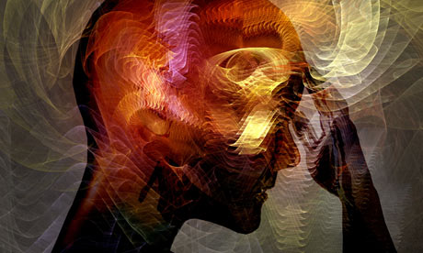
Introduction & etiology of psychiatric illness
Psychiatry department
Beni Suef University

Slide 2
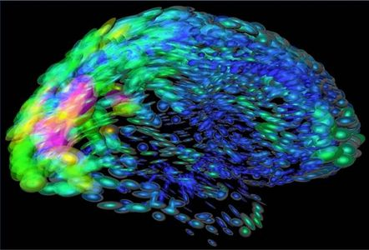
What is psychiatry?
Psychiatry is the branch of Medicine that deals with the diagnosis and treatment of Psychiatric Disorders.
Psychiatric disorders are disorders in mental or psychological functions manifested as disorders of perception, thinking, emotions. decision making and motor behavior.
Psychiatry is different from Psychology. Psychology is the scientific study of individual human behavior (perception, thinking, emotion and motor behavior).

Slide 3
Importance of studying psychiatry
psychiatric disorders are widely spread, may be more prevalent than most other medical disorders.
Many of physical complaints presenting to other medical specialties are primarily symptoms of pure psychiatric disorders.
The psychiatric aspect of patients with medical and surgical disorders plays an important role in the prognosis and management of those patients.
Psychiatric patients always perform at a lower level than expected making them a great economic burden and a source of lots of familial and social problems.

Slide 4
World health organization report
In October 2001, the WHO Yearly Report cited four psychiatric disorders among the top ten diseases that caused worldwide disability in all age groups. They are:
Unipolar Depression (ranked 1st),
Alcohol Use Disorders (ranked 5th),
Schizophrenia (ranked 7th), and
Bipolar Mood disorder (ranked 9th).

Slide 5
The Mind-Brain Relationship
Mental functions such as memory, learning, habituation, and conditioning are now defined in neuromolecular and neurophysiological terms.
For example, consolidation of memory is now believed to be the product of long term potentiation inside the neuron.
This alters synaptic activity resulting in actual change in synaptic structure. These processes may be visualized in the brain by special neuroimaging techniques.
This ability of brain synapse to alter its configuration in response to experience is called brain plasticity.
This means that psychological influences lead to functional and structural changes in the brain, e.g.. psychotherapy.
It also means that experience shapes the structure of the brain.

Slide 7
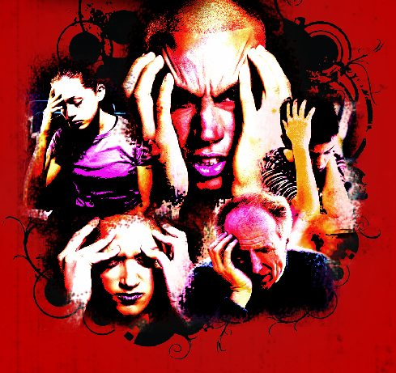
Evaluation of Normality and Abnormality
In psychiatry, a person is considered abnormal (disordered) if he displays two major characteristics:
(1) clear psychiatric symptoms and signs leading to significant distress to the patient or suffering to others; and
(2) manifest decline in social and vocational adjustment.

Slide 8
Etiology of Psychiatric Disorders
Etiology or causation of psychiatric disorders is a complex issue. This complexity has several aspects :
psychiatric disorders are caused by the interaction of a multitude of biological, psychological and social factors.
separation of time between the cause and effect

Slide 9
The Bio-Psycho-Social Model
According to this model psychiatric disorders arise from the combined effect or interaction of biological, psychological and social factors.
Biological, psychological and social factors create a vulnerability (i.e. readiness) to develop certain psychiatric disorders.
Negative or traumatic psychological experiences operating during childhood development add to this vulnerability.
Later in life the impact of significant stressors,, activates pathological processes that lead to the emergence of disorder.

Slide 10
The Bio-Psycho-Social Model of Etiology of Psychiatric illness
1- Biological Factors
A-Genetic Factors
B- Neurochemical and neuroendocrine factors
C- Neurophysiological and neuropathological factors
2- Psychological Factors
3- Social Factors
Predisposing, Precipitating and Perpetuating Factors

Slide 11
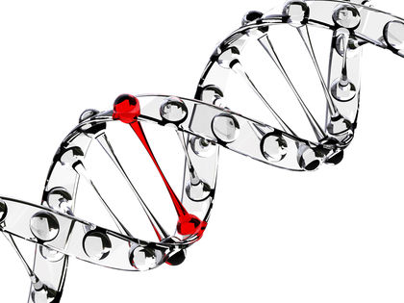
Genetic Factors
i- For most psychiatric disorders the mode of inheritance is polygenic (i.e., combined action of multiple genes).
ii- The degree of genetic contribution to disorder differs in relation to different psychiatric disorders, e.g., the role of genetic aspects in schizophrenia is higher than their role in relation to anxiety disorders.
iii- In most instances genetic factors may not lead to manifest psychiatric disorders unless they interact with unfavorable environmental developmental factors.
These factors may be biological (intrauterine, perinatal or later in life) or psychosocial (developmental traumatic experiences and stressors).

Slide 12
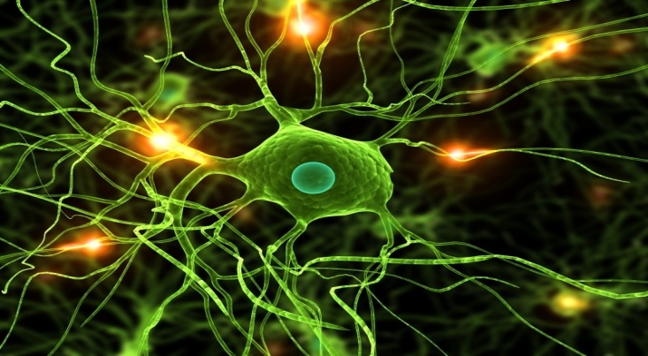
B- Neurochemical and neuroendocrine factors
Most psychiatric disorders are associated with dysregulation in different brain neurotransmitter systems, e.g.
Schizophrenia is associated with identifiable dysfunctions in dopamine, serotonin and possibly other neurotransmitter systems.
On the other hand, some psychiatric disorders may be associated with certain neuroendocrine dysfunctions, e.g..
Depressive Disorders are usually associated with hypothalamo-pituitary-adrenal axis over activity.

Slide 13
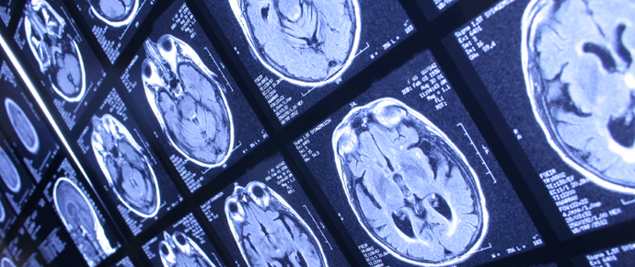
C- Neurophysiological and neuropathological factors
Recent advances in neuroimaging (e.g. C.T, MRI, and PET) and other brain investigative techniques have made it possible to study different functional and structural (anatomical) changes associated with psychiatric disorders.
Certain neurophysiological (i.e. functional) changes such as changes in cerebral blood flow, brain electrical and neuronal circuit activity may characterize different psychiatric disorders.

Slide 14
2- Psychological Factors
Vulnerability to psychiatric disorder is strongly related to negative or adverse psychological influences
They include:
a- Traumatic psychological experiences such as separation or loss of parents, physical or sexual abuse, and parental indifference or neglect.
b- Pathological patterns of relationships with significant people particularly the parents.
c- Defective development of personality or self due to defective satisfaction of essential psychological needs by caregivers.

Slide 15
3- Social Factors
Negative or adverse psychosocial circumstances contribute to predisposition to or precipitation of psychiatric disorder. They include:
a- Stressful life events, e.g. death of loved people, financial loss or loss of job, divorce, serious health problems, etc....
b- Stresses of social milieu, e.g. stresses related to social class, culture or social change in the society, etc....
c- The nature of the society (industrial versus agricultural, rural versus urban).

Slide 16
Etiology of psychiatric illness
From a different perspective etiological factors of psychiatric disorders can be classified in terms of predisposing, precipitating and perpetuating (maintaining) factors.

Slide 17
1- Predisposing Factors:
These are factors which operate from early life and determine the person's vulnerability to the disorder.
They include genetic factors, intrauterine factors as well as physical, psychological and social factors.
Constitutional factors are the physical and mental make up.
They form together the type of the individual's personality.
This latter is important in explaining the particular way of reaction to the precipitating factors.

Slide 18
2- Precipitating Factors
These are events that occur shortly before the onset of a disorder and appear to have induced it.
They may be physical (e.g. trauma, infection, intoxication, etc...)
psychological (e.g. conflicts, frustration, deprivation or bereavement) or
social factors.
They require a predisposed individual to exert their effect. They do not influence the pattern of the illness or its intensity.

Slide 19
3. Perpetuating ( Maintaining ) Factors
These are factors that prolong the course of illness and counteract therapeutic efforts.
They may be biological or psychosocial in nature.

Slide 20
Thank You

