Slide 1
SYSTEMIC LUPUS ERYTHEMATOSUS

Slide 3
SLE is an inflammatory autoimmune disorder characterized by autoantibodies to nuclear antigens. It can affect multiple organ systems.
It affects mainly females (9:1) with peak incidence in the second & third decades.

Slide 4
Aetiology(Autoimmune disorder)
1- Defect in T suppressor lymphocytes and formation of autoantibodies to a variety of antigens.
2- Environmental factors leading to oxidative stress e.g. exposure to sunlight, pregnancy and infection.
3- Drugs: like hydralazine, procainamide (drug induced lupus)
4- Hormonal factors: : SLE is common in child bearing period& in those who using contraceptive pills.

Slide 5
Clinical picture
1- Fever.
2- Musculoskeletal:
Bilateral and symmetrical arthralgia of joints.
Non deforming but tenosynovitis may lead to deformity (Jaccoud᾽s arthropathy).

Slide 6
3- The skin:
Malar rash: butterfly rash
Discoid rash
Photosensitivity
Purpuric eruption with vasculitis or thrombocytopenia.
Alopecia
Raynaud᾽s phenomenon.
Urticaria

Slide 8
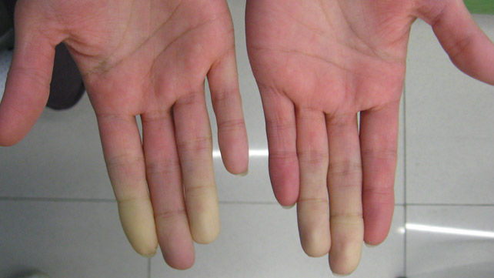

Slide 10
4- The eye:
Retinal vasculitis
Episcleritis , conjunctivitis
Keratoconjunctivitis sicca.

Slide 11
5-The heart:
Pericarditis & pericardial effusion.
Myocarditis with heart failure.
Libman sacks endocarditis.
Hypertension
Coronary artery disease

Slide 13
6-The kidney:
LUPUS NEPHRITIS
7- The lung:
Pleurisy and pleural effusion.
Interstitial lung disease.
Shrinking lung syndrome with elevation of diaphragm due to recurrent pulmonary infarction.
Pulmonary hypertension
Adult respiratory distress syndrome.

Slide 14
8- GIT:
Mesenteric vasculitis with acute abdomen
9- Neurological:
Psychosis.
Seizures
Polyneuropathy.
Lupus headache

Slide 15
10- Blood:
Autoimmune thrombocytopenia and hemolytic anemia.
Leucopenia& lymphopenia.
11- Serositis:
of pleura, pericardium& peritoneum

Slide 17
Investigations
1- CBC: N.N.anemia, autoimmune hemolytic anemia, leucopenia, lymphopenia.
2- ESR: increased.
3- ANA: positive in 95% of cases.
4- Anti-DsDNA: is most specific and reflect disease activity.
5- C3&C4 are consumed during disease activity.
6- Anti Ro& Anti La antibodies.
7- Anti Smith antibody (specific for SLE).
8- Kidney biopsy.

Slide 19
Treatment
All patients require education and general prophylactic measures to prevent disease flares:
1- Sunscreens and protective clothing to avoid photosensitive reactions.
2-Avoiding use of oral contraceptive pills as they increase the disease activity.
3- Avoidance of vasoconstrictive drugs for treating Raynaud᾽s phenomenon.
4- Psychological support for depression and anxiety.
5- Routine immunization for influenza and pneumococcai are recommended.

Slide 20
Pharmacological therapy:
1- NSAIDs: for arthralgia, fever and serositis.
2- Hydroxychloroquine& topical steroids for skin manifestations.
3- Corticosteroid therapy is the main subject of treatment.
Either: pulse methylprednisolone OR oral prednisolone (full dose).

Slide 21
4- Immunosuppressive therapy:
Cyclophosphamide
Mycophenolate Mofetil
Azathioprine
Cyclosporine
5- Biologic therapy:
TNF inhibitors
IL1& IL6 blockers
T cell costimmualtory inhibitor
6- Plasmapheresis in sever exacerbations

Slide 22
THANK YOU
&
GOOD LUCK

