Slide 1
Psychotherapy
Psychiatry department
Beni Suef University

Slide 2
Psychotherapy
Definition
A process which attempts to help the patient relieve symptoms, resolve problems or seek personal growth through a structured relation (i.e. specified goals and methods) with a trained professional therapist.
The therapist may be a psychiatrist, a psychologist, a nurse, etc...

Slide 3
Types of Psychotherapy
A. According to Format:
B. According to content (the applied personality theory)
1- Individual therapy.
2- Group therapy.
3- Family therapy.
4- Marital therapy.
5- Community or Milieu therapy.
1 - Supportive.
2- Expressive (dynamic or insight oriented).
3- Behavioral.
4- Biofeedback
5- Cognitive-Behavioral
6- Experiential (Humanistic approach).
7- Rehabilitation and activity therapies.

Slide 4
Supportive Psychotherapy
Definition and Aims
It is the form of therapy that deals with conscious conflicts and current problems.
It aims at supporting the patient and helping him to:
1- Relieve symptoms and resolve problems.
2- Regain equilibrium and maintain stability.
3- Achieve better adaptation, coping and functioning.

Slide 5
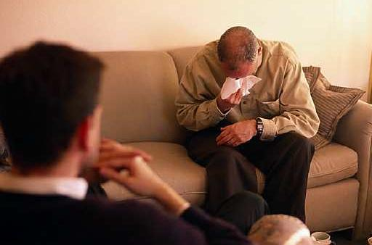
Supportive Psychotherapy
Indications
1 - Crisis, acute distress or acute adjustment disorders.
2- Chronic or handicapped patients (e.g., chronic Schizophrenia, mood or personality disorders).
3- Patients who do not need (not motivated) or not fit (lacking ego strength or intellectual ability) for deeper expressive therapy.

Slide 6
Techniques of supportive psychotherapy
Establishing an emphatic understanding relation (therapeutic alliance).
Active listening (empathic).
Reassurance and encouragement.
Suggestion, advice and persuasion.
Clarification and explanation (education), e.g., as regards symptoms, interpersonal problems and ways of coping.
Strengthening useful defenses.
Suppression of unwanted conflicts.
Improving ego strength and functioning (e.g., reality testing, autonomy, etc...).
Environmental manipulation and modification.
Help in improving insight.

Slide 7
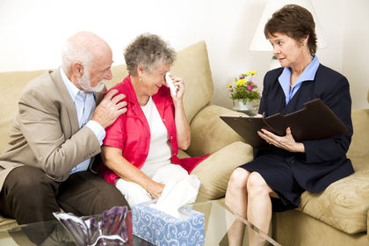
Supportive psychotherapy
Duration of Psychotherapy
According to the patient's needs, it could be a single session or prolonged to many years.
Format
It is usually individual but can be used in all formats.
Complications
Mainly dependency on therapist

Slide 8
Psychodynamic (Expressive) Therapy
• A group of deep therapies that aim at symptom resolution as well as producing positive fundamental changes in the patient's
character or personality.

Slide 9
Psychodynamic (Expressive) Therapy
This is achieved through:
Uncovering unconscious conflicts and shift them to the conscious awareness of the patient.
Help the patient resolve the conflicts and correct deficits through understanding and insight
Induce change motivated by insight.
Corrective relational and emotional experiences with the therapist.

Slide 10
Types of psychodynamic therapy
Psychodynamic psychotherapy includes a variety) of models, e.g.. classical
psychoanalysis (of limited use now),
psychoanalytic oriented models,
short-term models,
object relation and
self-psychologv models, etc....

Slide 12
Psychodynamic therapy
enough ego-strength to tolerate the experience of change and growth.
The patient should also he capable of expressing his thoughts and emotions.
It can be long term (years) but short-term models are more commonly used.

Slide 14
Psychodynamic therapy
The short-term techniques are characterized by being:
1- Time-limited. i.e.. weekly sessions for 3-6 months.
2- Problem-focused. i.e.. focused on limited key aspects of the patient's psychopathologv.

Slide 16
Behavioral Therapies
Behavioral therapy is based on the theory that symptoms are persistent maladaptive behaviors acquired by conditioning or learning.
Therapy consists of "deconditioning" or "unlearning" of such behavioral habits and "relearning" of new adaptive behaviors.
e.g., phobia

Slide 17
Techniques of behavioral therapy
1- Systematic desensitization
2- Graded exposure
3- Flooding
N.B. The above techniques are useful in phobic, and obsessive
compulsive disorders and some sexual disorders.
4- Aversive conditioning
e.g.,: In treating alcoholism (Disulfiram)
5- Positive reinforcement (reward)
chronic patients (e.g.. schizophrenia, autistic disorder, M.R..).
6- Participant modeling

Slide 18
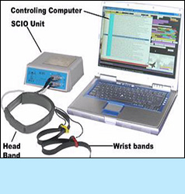
Biofeedback
It is based on the idea that physiological functions (e.g., B.P., HR., muscle tension, etc...) which are not controlled voluntarily can be brought under voluntary control through operant conditioning if a person is provided with feedback information about these functions.

Slide 19
Method of biofeedback
Information from measuring devices (e.g.. B.P., skin temperature or galvanic response, EMG, EEC ...) is transformed by electronic instruments into signals that can be perceived by the patient (e.g.. a sound or flashing light).
On receiving these signals, the person can be trained to control those functions and reach a related euthymic mental state.

Slide 21
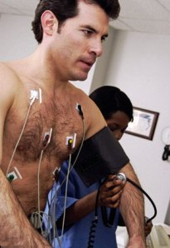
Indications of biofeedback
It is used in the management of many psychosomatic conditions
including hypertension, arrhythmias, migraine, tension headache, etc....

Slide 22
Cognitive-Behavioral Therapy
Theory
Based on the theory that a person's affect and behavior are largely determined by the way in which he cognitively structures and interprets the world (cognitive schemata developed from previous experience).
When faced with any situation, we respond with certain immediate interpretations (called automatic thoughts) which are highly influenced by our underlying or hidden beliefs or assumptions.

Slide 23
Aim of cognitive behavioral therapy
To identify and correct cognitive distortions (automatic thoughts and underlying beliefs) and maladaptive behaviors that result from them
through a combination of verbal and behavior modification techniques.

Slide 25
Techniques of CBT
A- Cognitive (verbal) techniques
1- Identify and test automatic thoughts, i.e., test their rationality as hypotheses rather than facts.
2- Identify and test the underlying assumptions or core beliefs.
3- Correcting the distorted cognitions and replacing them with positive and more adaptive cognitive habits.
4- Rehearsal of the new cognitive and behavioral responses.

Slide 26
Techniques of CBT
B- Behavioral Techniques:
methods including:
1- Activity scheduling.
2- Graded task assignment (e.g., graded social activity to correct social withdrawal).
3- Rehearsal of new behavior.
4- Rating of progress in the amount of mastery and pleasure.
5- Diversion techniques: e.g., physical activity and exercise, work, social contact.

Slide 28
Characteristic Features of CBT
1- Duration:
Short-term and time limited, usually 15-20 sessions, over 3 months
2- Therapist role:
Active, directive, understanding and empathic
3- Focused on:
a. Conscious aspects of experience and behavior.
b. Current (here and now) problems.
4- Structured:
a. Problems and goals operationally defined.
b. Agenda prepared for each session.
5- Format:
Usually individual but can be used in other formats

Slide 29
Indications of CBT
1- Depressive disorders (non-psychotic).
2- Anxiety disorders
e.g.. panic, phobic and generalized anxiety disorders.
3- Obesity and eating disorders.
4- Substance related disorders.

Slide 30
Group Psychotherapy
Definition
A form of therapy in which therapeutic changes occur as a result of the interactions of patients with other patients and at least one trained professional therapist in a group setting.

Slide 31
Group Psychotherapy
Goals
1- Relief of symptoms.
2- Resolution of intrapsychic and interpersonal problems through insight and corrective experiences.
3- Encouraging personality growth and development.

Slide 32
Group Psychotherapy
Characteristics
-Size: 6-12 patients (optimum 8).
-Time: 1-2 hours once or twice weekly.
-Duration: months to years depending on goals and therapy model.

Slide 33
Group Psychotherapy
Type of patients:
1. Heterogeneous (different diagnoses).
2. Homogeneous (single diagnosis, e.g., special groups for substance abuse or PTSD).

Slide 34
Group Psychotherapy
- Model of therapy (content):
supportive,
psychodynamic,
experiential,
cognitive and behavioral models.
interactional model (Yalom),
Transactional analysis (Bern) and
Psychodrama.

Slide 35
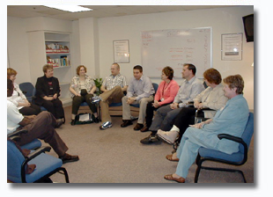
Group Psychotherapy
Indications
Almost all diagnoses except:
acute manic or
Acute psychotic episodes and
antisocial personality disorder

Slide 36
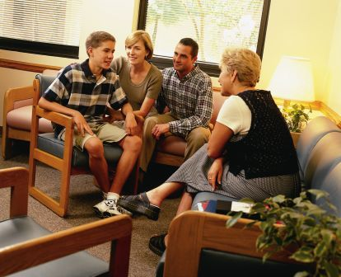
Family Therapy
Family therapy is based on the idea that the patient's psychological disturbance reflects a significant disturbance of his family,
i.e., disturbed patterns of behaviors and relations among his family members.

Slide 37
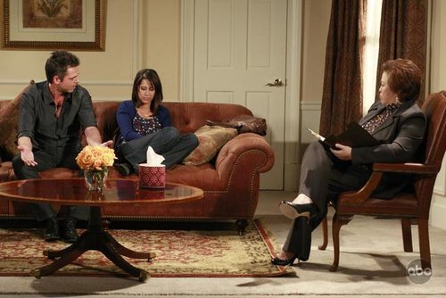
Family Therapy
Therapy aims at helping family members gain insight into their problems and disturbed relational patterns and change their dysfunctional behavior and emotions into a healthier pattern.

Slide 38
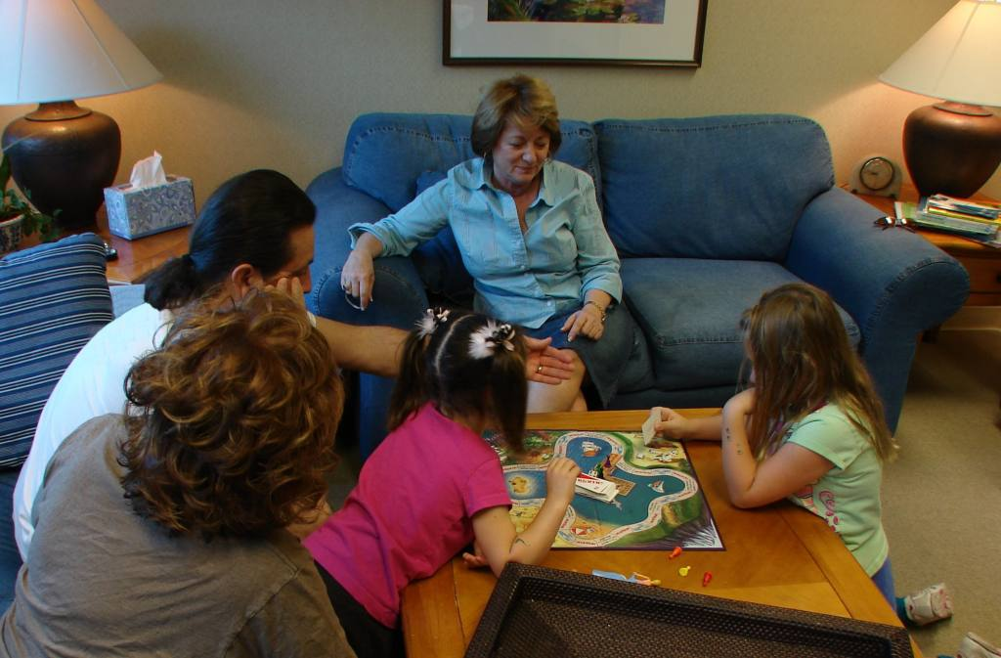
Family Therapy
The focus of therapy is the family as a whole rather than the individual patient.
The family is viewed as a system suffering from dysfunctions resulting from disturbed rules, roles and relations among its members.

Slide 39
Marital Therapy
A form of therapy concerned with maladjusted marital couples.
It aims at resolving interpersonal and related intrapsychic individual problems of the couple.
The therapy is focused on the "relationship" rather than any of the individual partners.

Slide 40
Rehabilitation
It is management of disabilities and handicaps resulting from psychiatric disorder conducted by trained therapists.
It is particularly important in chronic psychiatric disorders (such as chronic schizophrenia and mood disorders)

Slide 41
Rehabilitation
Aiming to improve the patient's performance in different functional domains including:
1. Personal hygiene and self-care skills.
2. Social and interpersonal skills
3. Vocational (work) and/or educational skills (occupational therapy).
4. Recreation and activity therapies, e.g., art, music, sports, celebration of social events, etc....

Slide 42
Milieu Therapy
An environment that is structured (organized) to assist patients to:
1. Control and modify problematic (maladaptive) behaviors.
2. Promote adaptive psychosocial skills in coping with the self, others and the environment.

Slide 43
Milieu Therapy
The focus is on social relationships as well as occupational and recreational activities.
To achieve its goals it uses different therapeutic modalities particularly:
1- Group therapies.
2- Different rehabilitative techniques.
3- Structured activities of daily living for all patients.

Slide 45
Team involved in Milieu therapy
Therapy is based on the coordinated work of a multidisciplinary team which includes
the psychiatrists,
psychologists,
psychiatric nursing staff, and
social workers
It also includes occupational, art, play and recreational therapists.

Slide 48
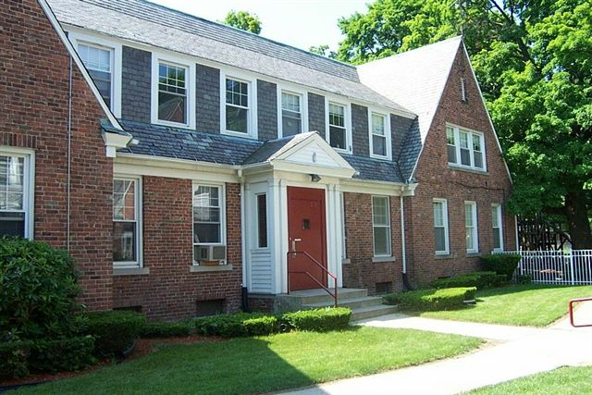
Place of Milieu therapy
It can be established in different locations, e.g.,
psychiatric hospitals,
psychiatric inpatient ward of a
general hospital,
day hospital,
special houses for geriatric patients, etc....

Slide 49
Thank you

